Slide 1


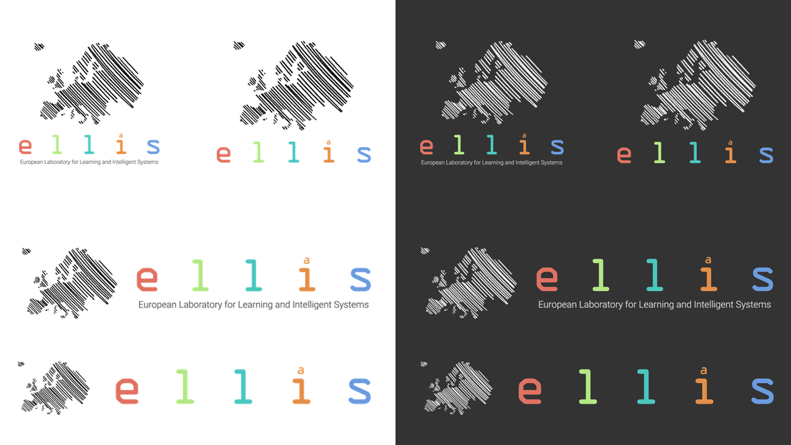

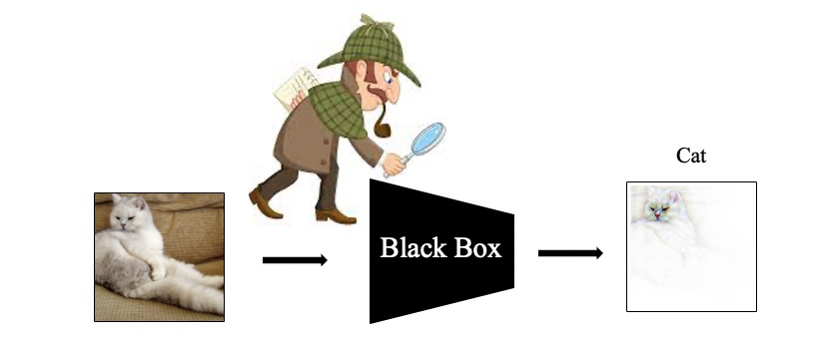
Intriguing Applications and Overlooked Pitfalls of XAI in Visual Models
Siddhartha Gairola, MPI for Informatics & IST
Talk @ GMUM Workshop, Jagiellonian University
19th October, 2024

Slide 2


Overview
Part 1
Nice applications of visual explanations
Model guidance with visual explanations [Rao et al. `23, Parchami et al. `24]
Part 2
Impact of training paradigm on visual explanations [Gairola et al. `24]
Talk @ GMUM 2024 | Siddhartha Gairola
2

Slide 3
Short Background on Interpretability and XAI (explainable Artificial Intelligence) for Vision
Talk @ GMUM 2024 | Siddhartha Gairola
3

Slide 4
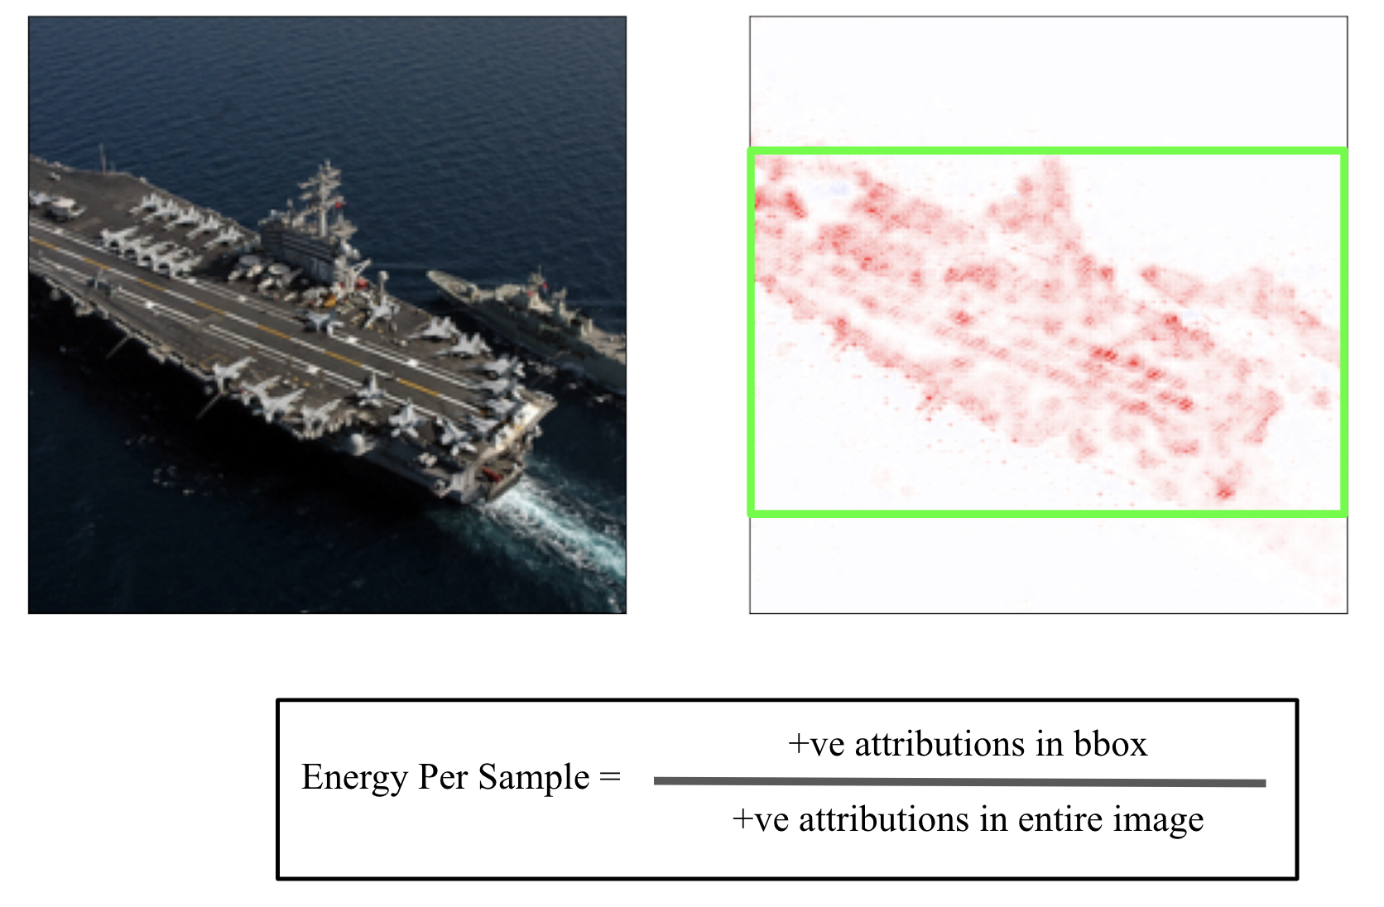
What is Interpretability? Model Explanations: Attributions
Deep Neural Networks (DNN) are black-box in nature
Black-box nature makes interpretation hard (Not trustworthy!)
This is a ship
Black Box
…
DNN
Talk @ GMUM 2024 | Siddhartha Gairola
4

Slide 5
What is Interpretability? Model Explanations: Attributions
Deep Neural Networks (DNN) are black-box in nature
Black-box nature makes interpretation hard (Not trustworthy!)
💭
🤔
This is a ship
But WHY?
Black Box
…
Talk @ GMUM 2024 | Siddhartha Gairola
5

Slide 6
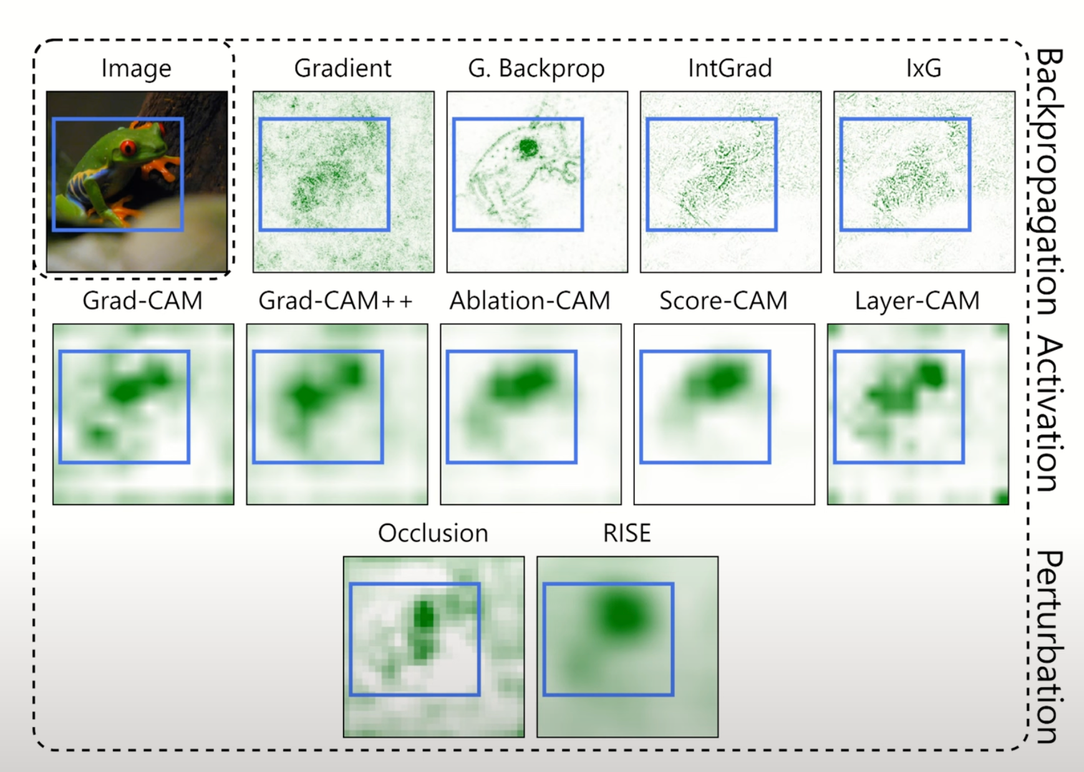
What is Interpretability? Model Explanations: Attributions
1
2
3
Gradient (Simoyan et al. 2014), G. Backpropagation (Springenberg et al. 2015), IxG (Shrikumar et al. 2017), Grad-CAM (Selvaraju et al. 2017), Grad-CAM++ (Chattopadhaya et al. 2018), Ablation-CAM (Desai et al. 2020), Score-CAM (Wang et al. 2020), Layer-CAM (Jiang et al. 2021), Occlusion (Zeiler et al. 2014), RISE (Petsuik et al. 2018)
Figure Credit: Sukrut Rao 2021
Talk @ GMUM 2024 | Siddhartha Gairola
6

Slide 7
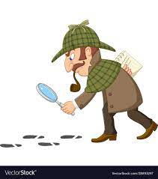

What is Interpretability? Model Explanations: Attributions
This is a ship
Black Box
…
Attribution for class ‘ship’
Talk @ GMUM 2024 | Siddhartha Gairola
7

Slide 8
Post-hoc Attribution Methods
Post-hoc -> applied after the model is trained!
Gradient (Simoyan et al. 2014), G. Backpropagation (Springenberg et al. 2015), IxG (Shrikumar et al. 2017), Grad-CAM (Selvaraju et al. 2017), Grad-CAM++ (Chattopadhaya et al. 2018), Ablation-CAM (Desai et al. 2020), Score-CAM (Wang et al. 2020), Layer-CAM (Jiang et al. 2021), Occlusion (Zeiler et al. 2014), RISE (Petsuik et al. 2018)
Talk @ GMUM 2024 | Siddhartha Gairola
8

Slide 9
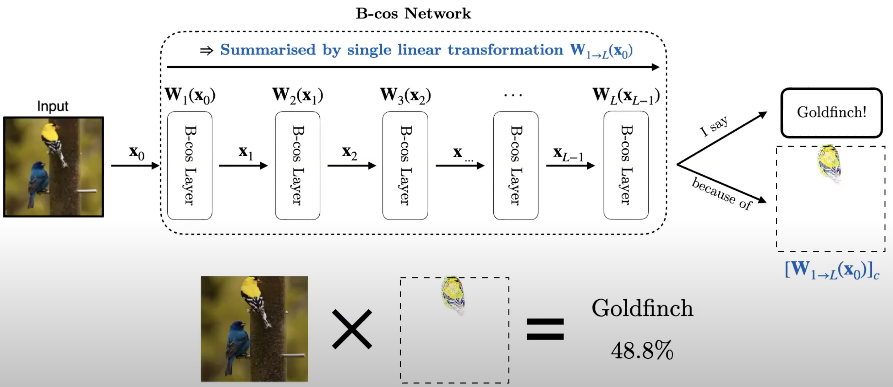

Inherently Interpretable Models: B-cos Networks
Designed & Optimised for Interpretability
B-Cos Nets (Böhle et al. 2022)
Talk @ GMUM 2024 | Siddhartha Gairola
9

Slide 10
Inherently Interpretable Models: B-cos Networks
Input-dependent Dynamic Linear Transform: y(x) = W(x).x
B-Cos Nets (Böhle et al. 2022)
Talk @ GMUM 2024 | Siddhartha Gairola
10

Slide 11
Inherently Interpretable Models: B-cos Networks
Entire network can be summarized by a single linear transformation
B-Cos Nets (Böhle et al. 2022)
Talk @ GMUM 2024 | Siddhartha Gairola
11

Slide 12
Inherently Interpretable Models: B-cos Networks
Input x [W_{1→L}(x₀)]_{c}
B-Cos Nets (Böhle et al. 2022)
Talk @ GMUM 2024 | Siddhartha Gairola
12

Slide 13
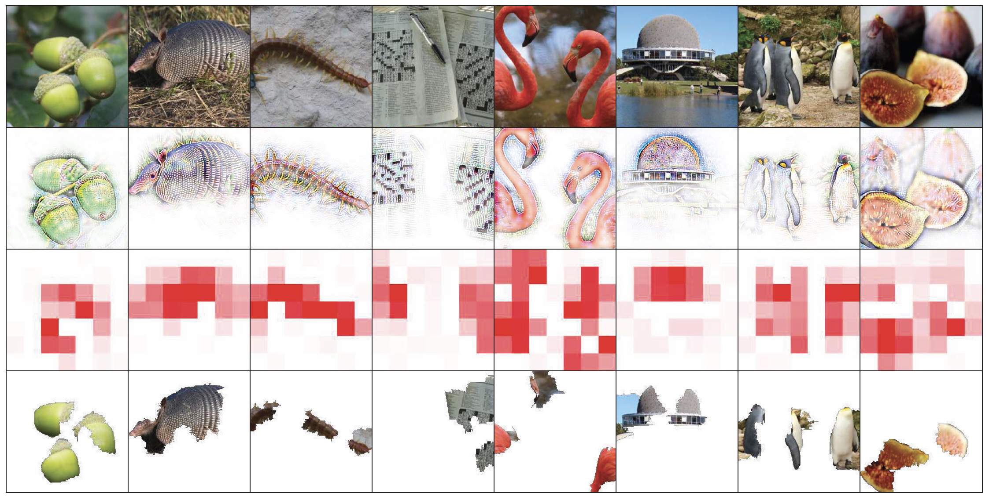
Inherently Interpretable Models: B-cos Networks
Input
B-cos
GradCAM
LIME
LIME (Ribeiro et al., 2016), GradCAM (Ramaprasaath et al. 2017), B-Cos Nets (Böhle et al. 2022)
Talk @ GMUM 2024 | Siddhartha Gairola
13

Slide 14
Overview
Part 1
Nice applications of visual explanations
Model guidance with visual explanations [Rao et al. `23, Parchami et al. `24]
Part 2
Impact of training paradigm on visual explanations [Gairola et al. `24]
Talk @ GMUM 2024 | Siddhartha Gairola
14

Slide 15
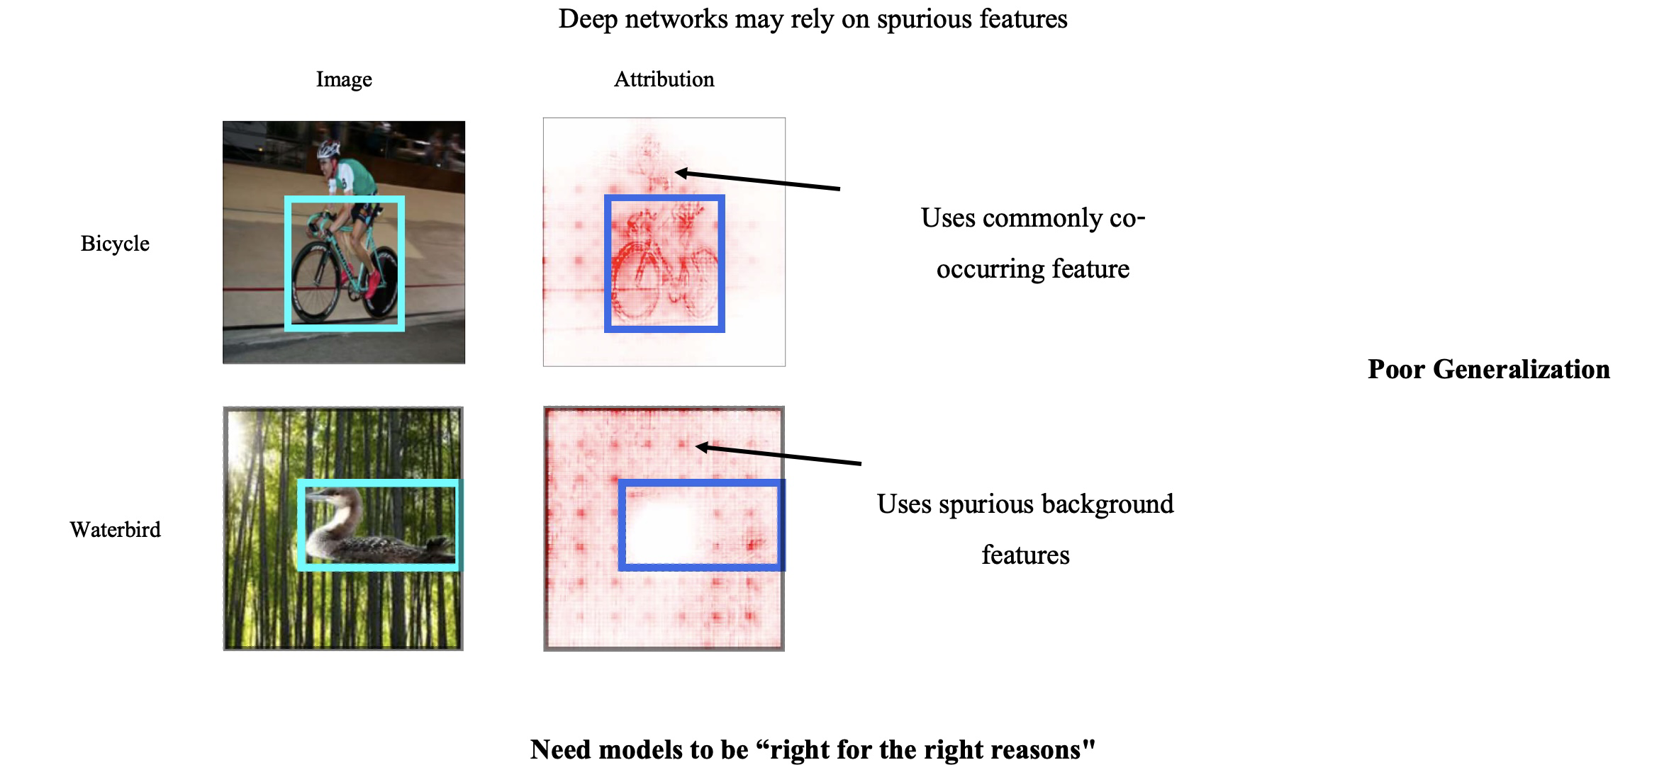

Guiding models with visual explanations
Motivation: Deep networks may rely on spurious features
Image
Attribution
Use commonly co-occurring features
Bicycle
Poor Generalization
Waterbird
Use spurious background features
Need models to be “right for the right reasons”
Model Guidance (Rao et al. 2023), Slide Credit – Sukrut Rao, 2023
Talk @ GMUM 2024 | Siddhartha Gairola
15

Slide 16
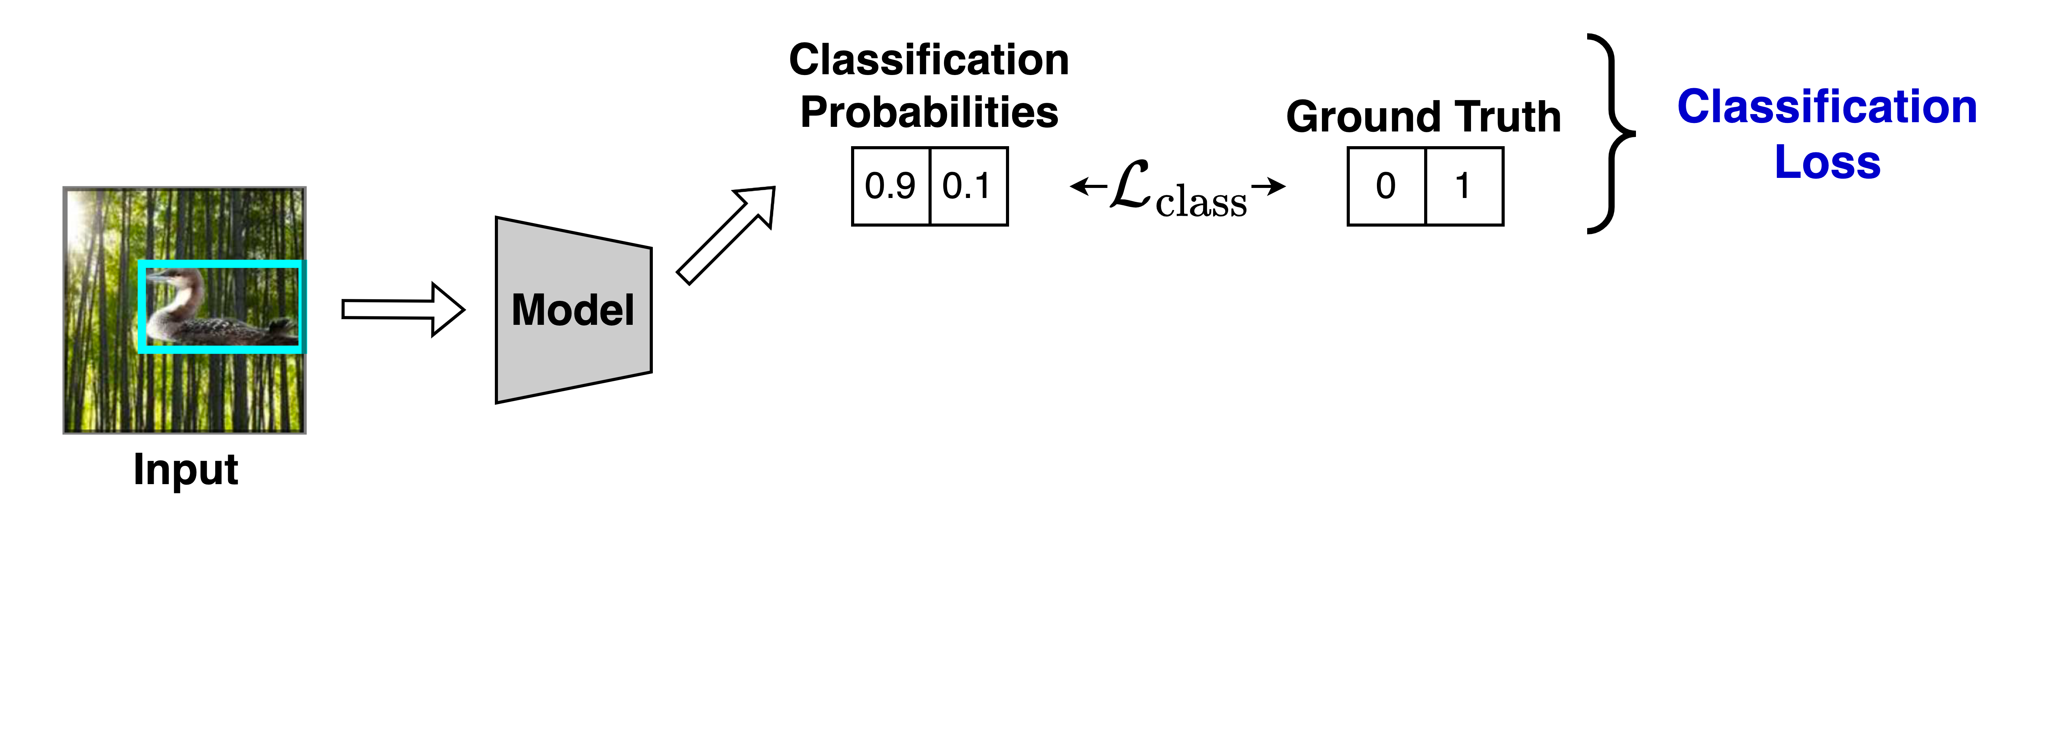
Guiding models with visual explanations
Leverage human annotations
Model Guidance (Rao et al. 2023), Slide Credit – Sukrut Rao, 2023
Talk @ GMUM 2024 | Siddhartha Gairola
16
Notes:
A way to address this is to guide models using human annotations. Here, while training, in addition to the standard classification loss…

Slide 17
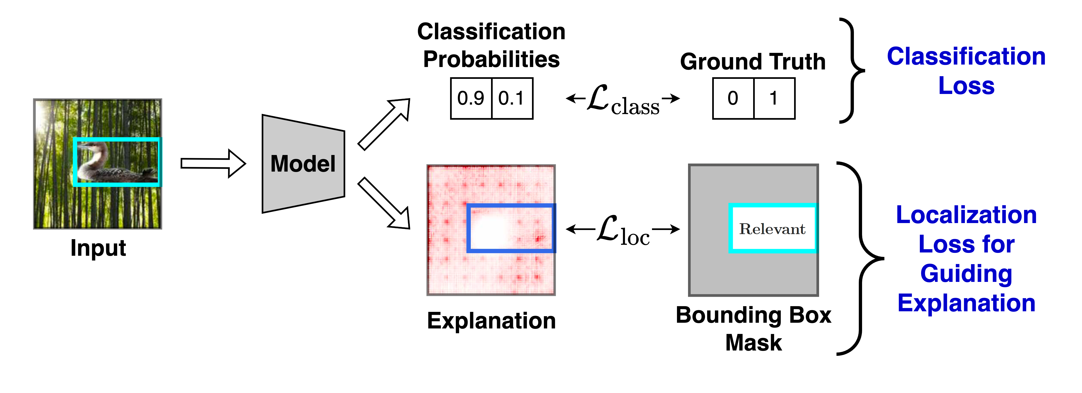
Guiding models with visual explanations
Leverage human annotations
Model Guidance (Rao et al. 2023), Slide Credit – Sukrut Rao, 2023
Talk @ GMUM 2024 | Siddhartha Gairola
17

Slide 18
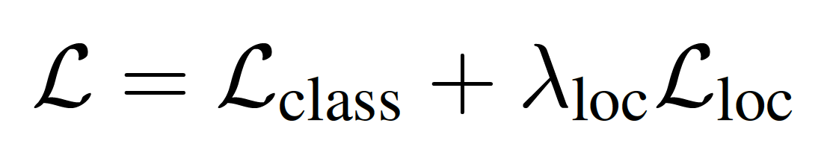
Guiding models with visual explanations
Leverage human annotations
Model Guidance (Rao et al. 2023), Slide Credit – Sukrut Rao, 2023
Talk @ GMUM 2024 | Siddhartha Gairola
18

Slide 19
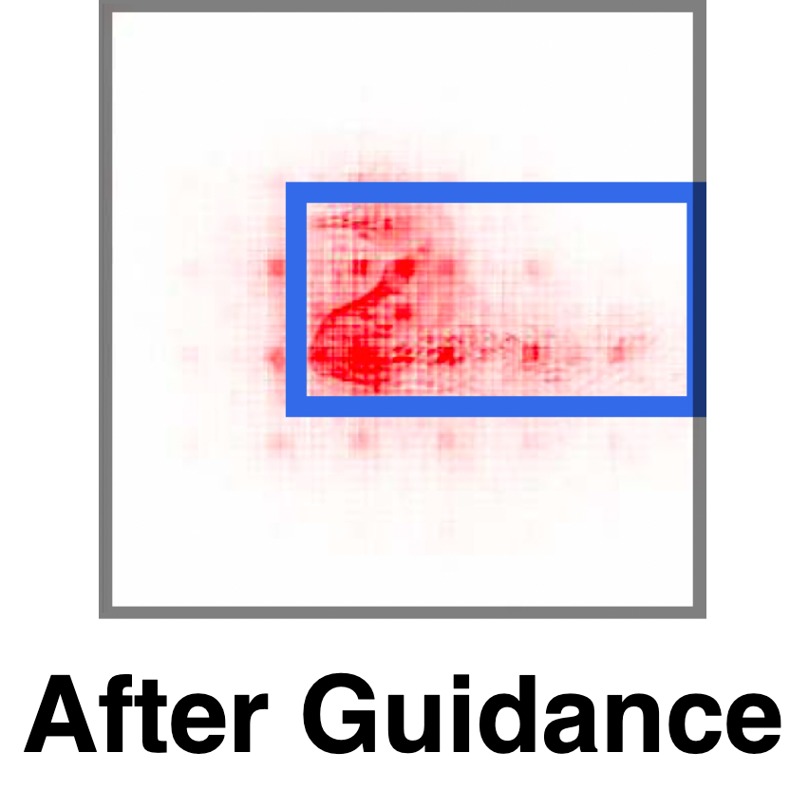
Guiding models with visual explanations
Leverage human annotations
Model Guidance (Rao et al. 2023), Slide Credit – Sukrut Rao, 2023
Talk @ GMUM 2024 | Siddhartha Gairola
19

Slide 20
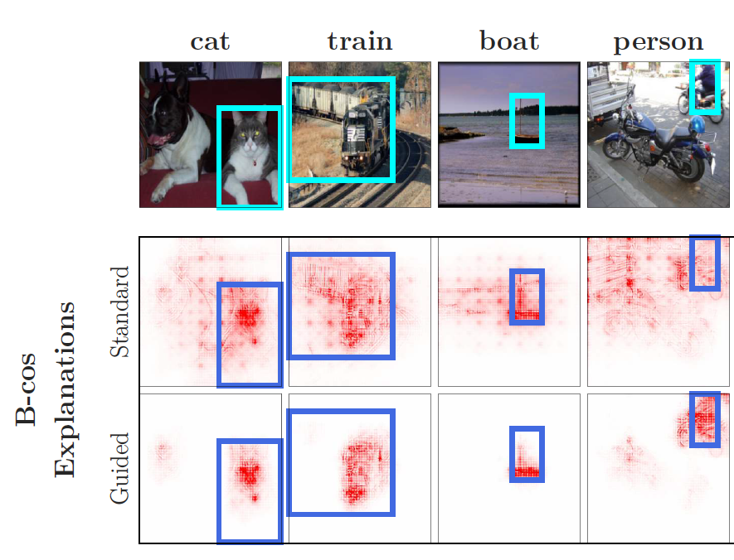
Guiding models with visual explanations
Leverage human annotations
Effective Guidance
VOC `07
Model Guidance (Rao et al. 2023), Slide Credit – Sukrut Rao, 2023
Talk @ GMUM 2024 | Siddhartha Gairola
20

Slide 21
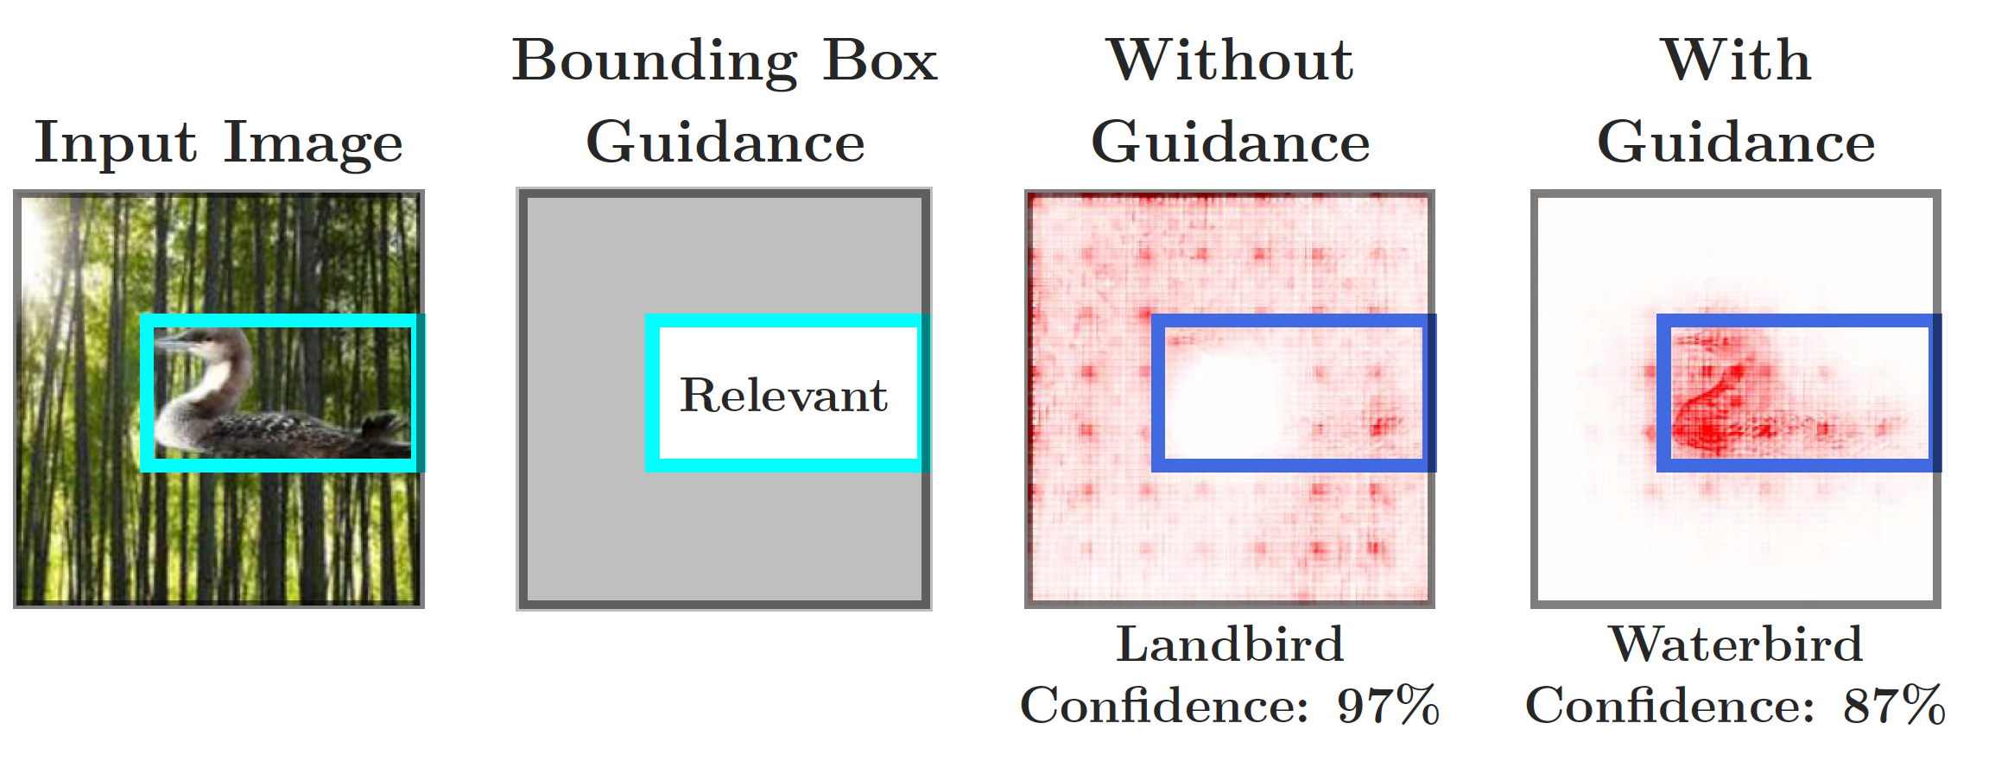
Guiding models with visual explanations
Leverage human annotations
Effective Guidance
“Right for the right reasons”
Waterbirds
Model Guidance (Rao et al. 2023), Slide Credit – Sukrut Rao, 2023
Talk @ GMUM 2024 | Siddhartha Gairola
21

Slide 22
Guiding models with visual explanations
Leverage human annotations
Efficient Guidance
Coarser BBoxes – Dilated by xx%
Model Guidance (Rao et al. 2023), Slide Credit – Sukrut Rao, 2023
Talk @ GMUM 2024 | Siddhartha Gairola
22

Slide 23
Guiding models with visual explanations
Summary so far -
We can leverage low-cost human annotations and visual explanations to guide models to be “right for the right reasons”.
Talk @ GMUM 2024 | Siddhartha Gairola
23

Slide 24
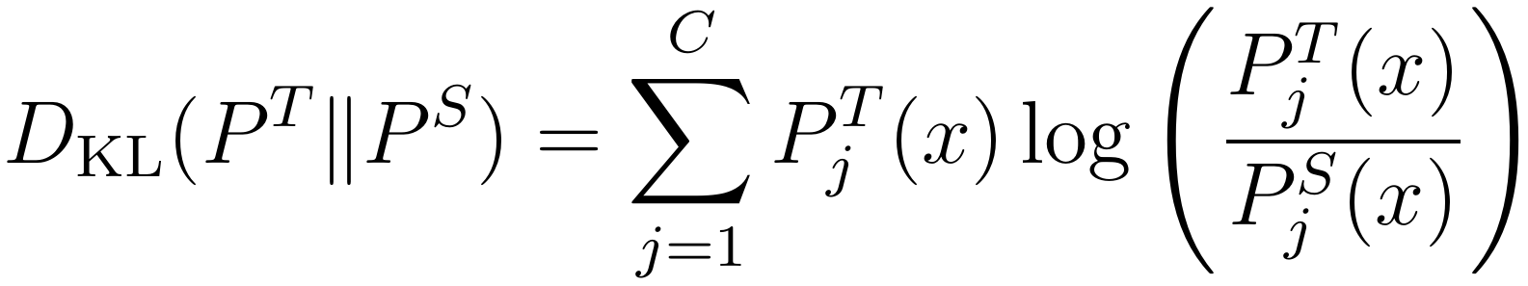

Guiding models with visual explanations - e²KD
Extension to Knowledge Distillation (or KD)
Vanilla KD simply matches the logits between teacher and student for every input.
P^{T}
P^{S}
D_{KL}
❄️
Teacher
Student
🔥
x
x
E²KD (Parchami et al. 2023), Slide Credit – Amin Parchami-Araghi, 2023
Talk @ GMUM 2024 | Siddhartha Gairola
24

Slide 25
Guiding models with visual explanations - e²KD
Extension to Knowledge Distillation (or KD)
Vanilla KD simply matches the logits between teacher and student for every input.
Goal: a student with the same accuracy as the teacher
Recently [1]: For long-enough distillation, the student can reach teacher’s accuracy.
But does this indicate a successful distillation?
[1] Beyer et al., Knowledge distillation: A good teacher is patient and consistent, CVPR 2022
E²KD (Parchami et al. 2023), Slide Credit – Amin Parchami-Araghi, 2023
Talk @ GMUM 2024 | Siddhartha Gairola
25

Slide 26
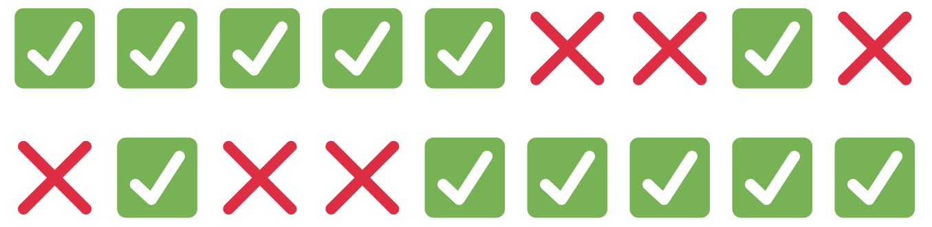
Guiding models with visual explanations - e²KD
Extension to Knowledge Distillation (or KD)
Besides accuracy, a recent work [2] evaluate the `agreement` b/w the two models.
Test Samples
Teacher
Student
Both 66% accurate, only 33% agreement.
Despite matching accuracies, the agreement can be significantly lower.
There can be a disparity between the two functions despite having same accuracy.
[2] Stanton et al., Does Knowledge Distillation Really Work?, NeurIPS 2021
E²KD (Parchami et al. 2023), Slide Credit – Amin Parchami-Araghi, 2023
Talk @ GMUM 2024 | Siddhartha Gairola
26

Slide 27
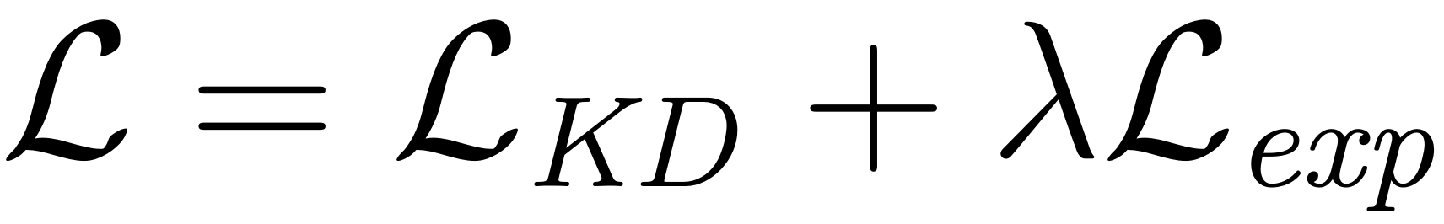
Guiding models with visual explanations - e²KD
Explanation enhanced knowledge distillation - e²KD
Leverage model guidance via pre-trained (teacher) models,
explore the benefits of simply optimizing for explanation similarity
E²KD (Parchami et al. 2023), Slide Credit – Amin Parchami-Araghi, 2023
Talk @ GMUM 2024 | Siddhartha Gairola
27

Slide 28
Guiding models with visual explanations - e²KD
Explanation enhanced knowledge distillation - e²KD
Leverage model guidance via pre-trained (teacher) models,
explore the benefits of simply optimizing for explanation similarity
Goal: Achieve Faithful KD
Faithful KD looks beyond accuracy, aiming for functionally similar Teacher and Student.
E²KD (Parchami et al. 2023), Slide Credit – Amin Parchami-Araghi, 2023
Talk @ GMUM 2024 | Siddhartha Gairola
28

Slide 29
Guiding models with visual explanations - e²KD
Explanation enhanced knowledge distillation - e²KD
Leverage model guidance via pre-trained (teacher) models,
explore the benefits of simply optimizing for explanation similarity
Goal: Achieve Faithful KD
Faithful KD looks beyond accuracy, aiming for functionally similar Teacher and Student.
E²KD (Parchami et al. 2023), Slide Credit – Amin Parchami-Araghi, 2023
Talk @ GMUM 2024 | Siddhartha Gairola
29

Slide 30
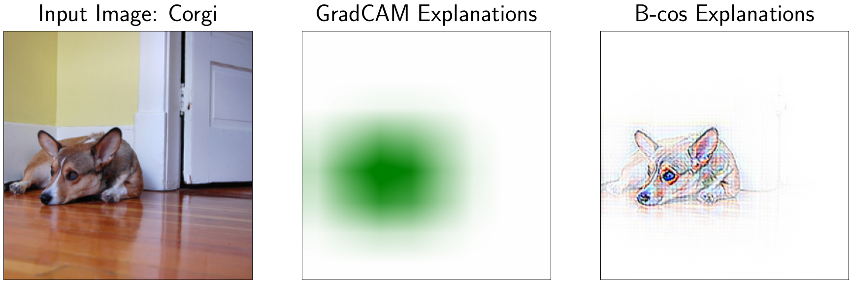
Guiding models with visual explanations - e²KD
Explanation enhanced knowledge distillation - e²KD
Leverage model guidance via pre-trained (teacher) models,
explore the benefits of simply optimizing for explanation similarity
Label- and Parameter-free
Model-agnostic
Utilize existing explanation methods
E²KD (Parchami et al. 2023), Slide Credit – Amin Parchami-Araghi, 2023
Talk @ GMUM 2024 | Siddhartha Gairola
30

Slide 31
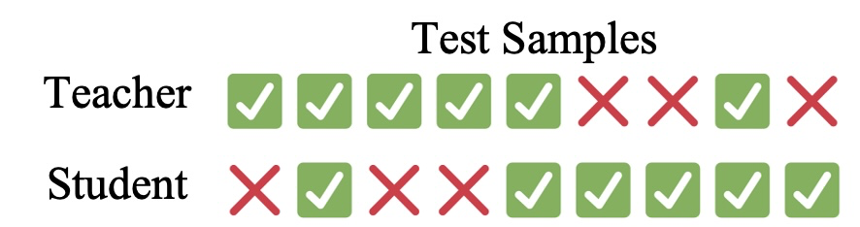
Guiding models with visual explanations - e²KD
Extension to Knowledge Distillation (or KD)
Goal: Achieve Faithful KD
Faithful KD looks beyond accuracy, aiming for functionally similar Teacher and Student.
This implies:
High teacher-student agreement.
Especially under limited-data settings
E²KD (Parchami et al. 2023), Slide Credit – Amin Parchami-Araghi, 2023
Talk @ GMUM 2024 | Siddhartha Gairola
31

Slide 32
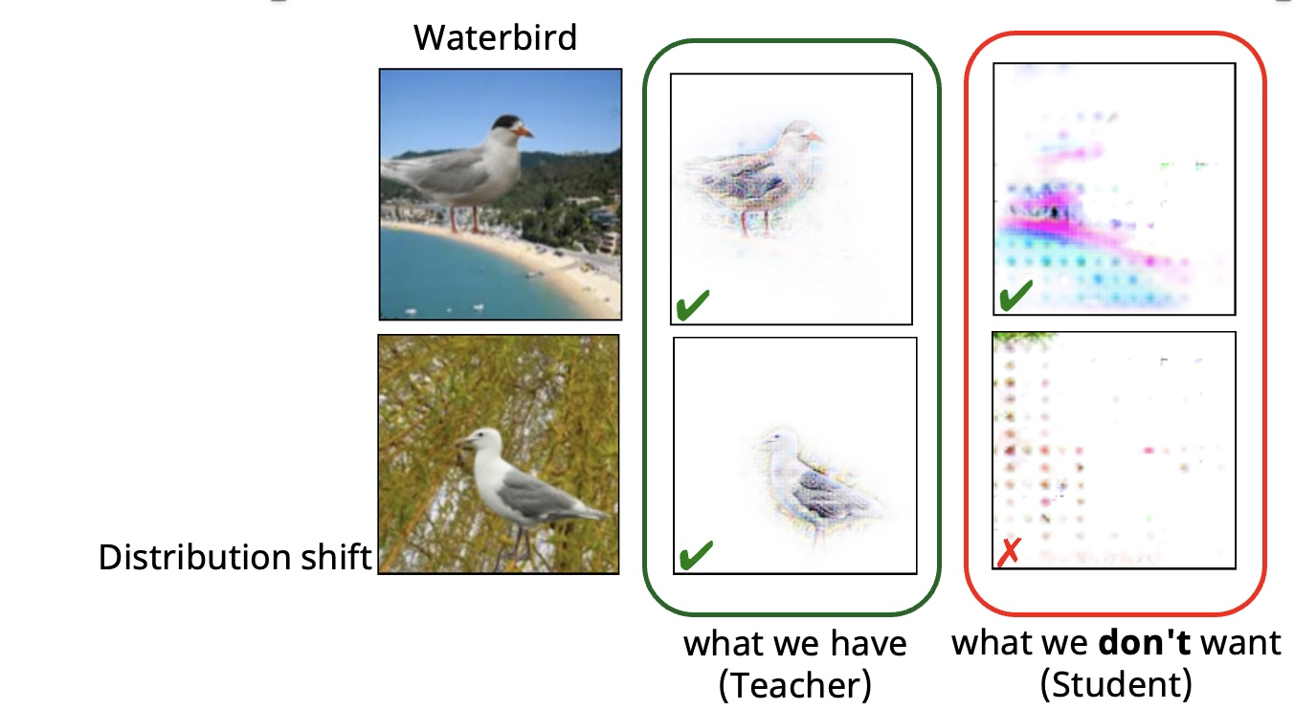
Guiding models with visual explanations - e²KD
Extension to Knowledge Distillation (or KD)
Goal: Achieve Faithful KD
Faithful KD looks beyond accuracy, aiming for functionally similar Teacher and Student.
This implies:
High teacher-student agreement.
Similar predictions, but for similar reasons
E²KD (Parchami et al. 2023), Slide Credit – Amin Parchami-Araghi, 2023
Talk @ GMUM 2024 | Siddhartha Gairola
32

Slide 33
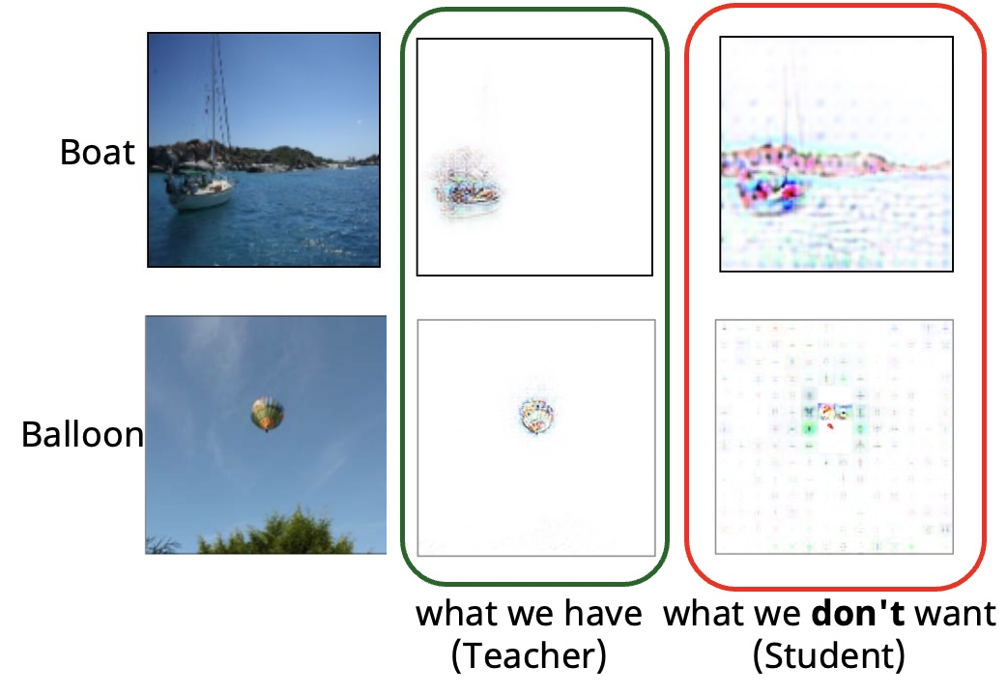
Guiding models with visual explanations - e²KD
Extension to Knowledge Distillation (or KD)
Goal: Achieve Faithful KD
Faithful KD looks beyond accuracy, aiming for functionally similar Teacher and Student.
This implies:
High teacher-student agreement.
Similar predictions, but for similar reasons.
Maintain the interpretability of the teacher.
E²KD (Parchami et al. 2023), Slide Credit – Amin Parchami-Araghi, 2023
Talk @ GMUM 2024 | Siddhartha Gairola
33

Slide 34
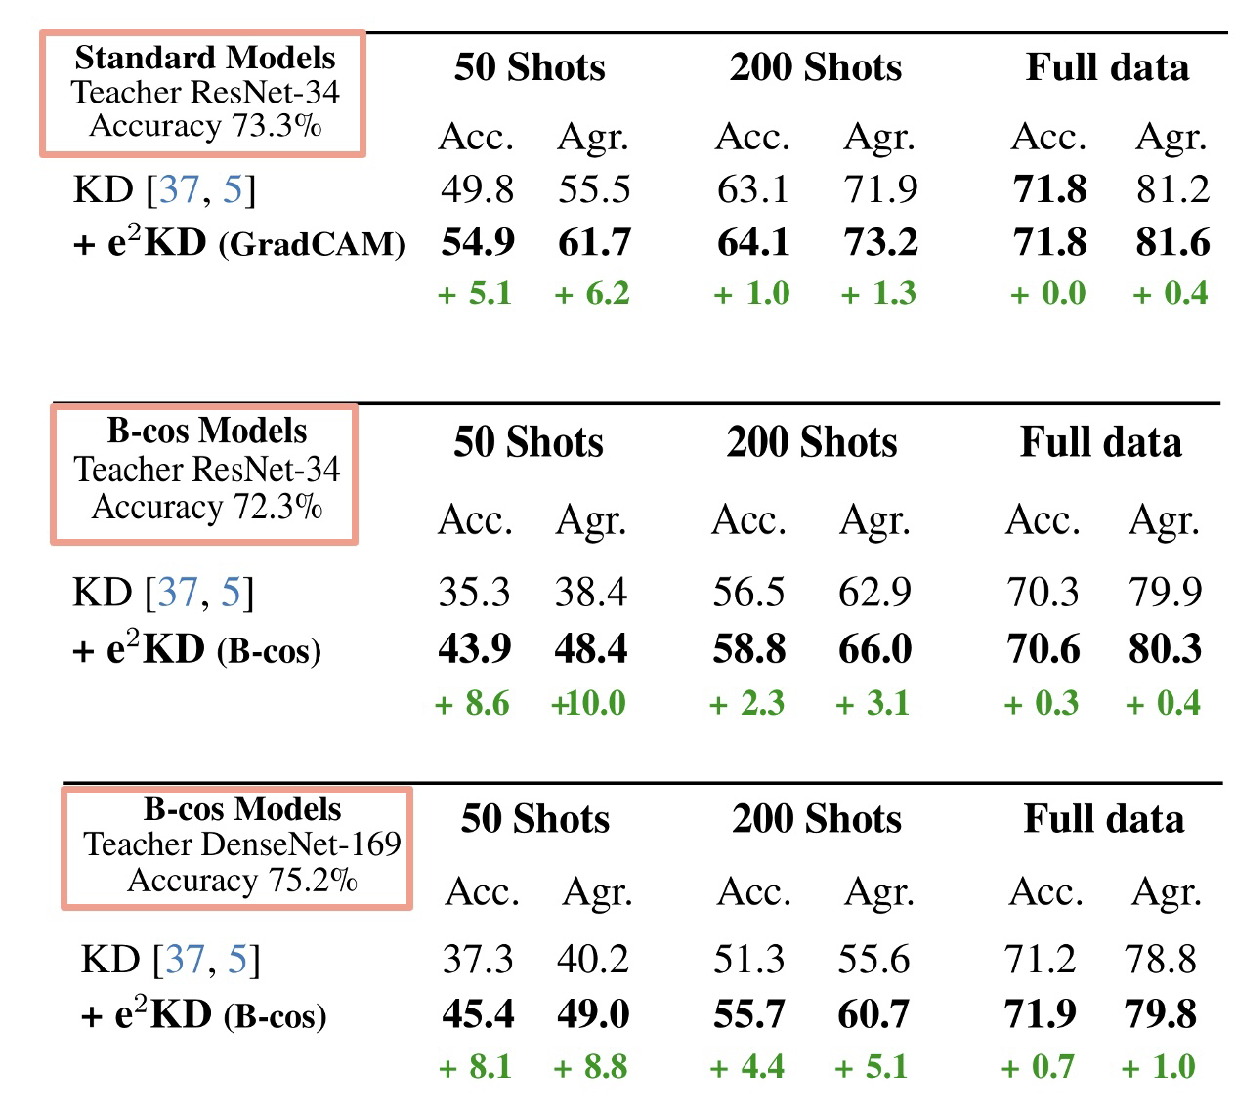
Guiding models with visual explanations - e²KD
Desideratum 1 – High agreement with teacher
Setting: ImageNet; RN34 -> RN18
Distill on varying amounts of data.
E²KD (Parchami et al. 2023), Slide Credit – Amin Parchami-Araghi, 2023
Talk @ GMUM 2024 | Siddhartha Gairola
34

Slide 35
Guiding models with visual explanations - e²KD
Desideratum 1 – High agreement with teacher
Setting: ImageNet; RN34 -> RN18
Distill on varying amounts of data.
Larger gains for smaller distillation sizes.
E²KD (Parchami et al. 2023), Slide Credit – Amin Parchami-Araghi, 2023
Talk @ GMUM 2024 | Siddhartha Gairola
35

Slide 36
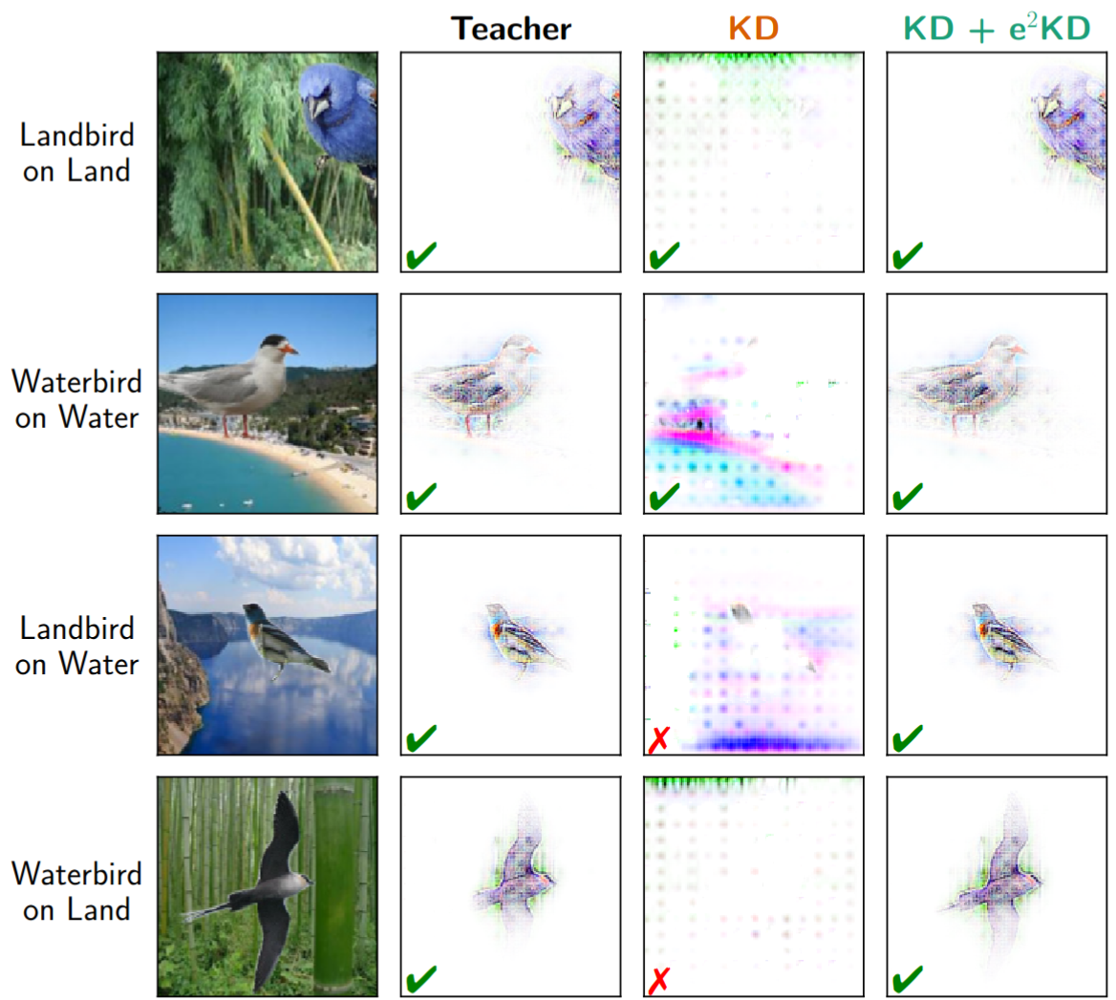
Guiding models with visual explanations - e²KD
Desideratum 2 – Learning the right features
Task: Classify Landbird vs. Waterbird
Distillation Data: Landbird on Land, Waterbird on Water
Test-time: Landbird on Water, Waterbird on Land
Teacher: ResNet-50 explicitly guided to focus on the bird
Focusing on the `Right' input features gives OOD robustness.
The student might deviate from the teacher!
E²KD (Parchami et al. 2023), Slide Credit – Amin Parchami-Araghi, 2023
Talk @ GMUM 2024 | Siddhartha Gairola
36

Slide 37
Guiding models with visual explanations - e²KD
Desideratum 2 – Learning the right features
Task: Classify Landbird vs. Waterbird
Distillation Data: Landbird on Land, Waterbird on Water
Test-time: Landbird on Water, Waterbird on Land
Teacher: ResNet-50 explicitly guided to focus on the bird
Focusing on the `Right' input features gives OOD robustness.
The student might deviate from the teacher!
e²KD effectively maintains correct reasoning!
E²KD (Parchami et al. 2023), Slide Credit – Amin Parchami-Araghi, 2023
Talk @ GMUM 2024 | Siddhartha Gairola
37

Slide 38
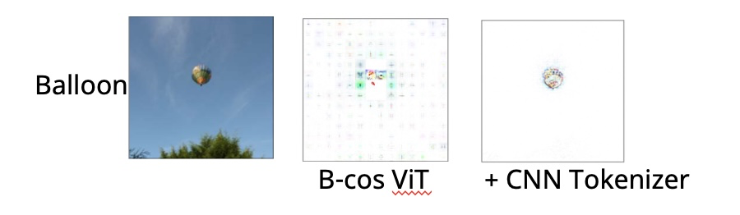
Guiding models with visual explanations - e²KD
Desideratum 3 – Maintaining Interpretability
Distill teacher with desirable properties.
Can we instead distill such a prior?
E²KD (Parchami et al. 2023), Slide Credit – Amin Parchami-Araghi, 2023
Talk @ GMUM 2024 | Siddhartha Gairola
38

Slide 39
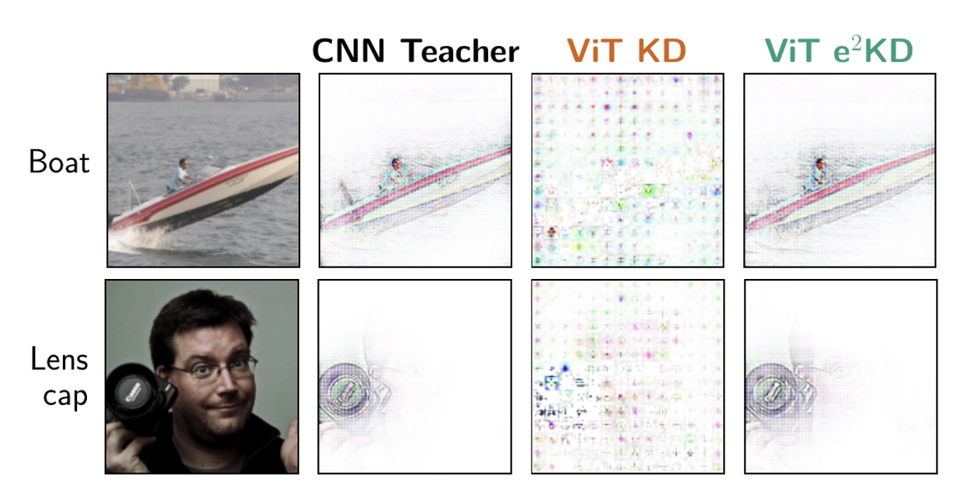
Guiding models with visual explanations - e²KD
Desideratum 3 – Maintaining Interpretability
Distill teacher with desirable properties.
Can we instead distill such a prior?
Distillation: B-cos DenseNet-169 → B-cos ViT_{Tiny}
Setting: ImageNet
E²KD (Parchami et al. 2023), Slide Credit – Amin Parchami-Araghi, 2023
Talk @ GMUM 2024 | Siddhartha Gairola
39

Slide 40
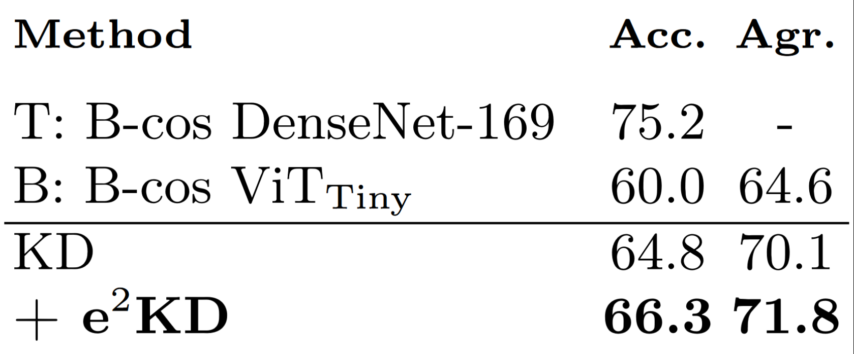
Guiding models with visual explanations - e²KD
Desideratum 3 – Maintaining Interpretability
Distill teacher with desirable properties.
Can we instead distill such a prior?
Distillation: B-cos DenseNet-169 → B-cos ViT_{Tiny}
Setting: ImageNet
E²KD (Parchami et al. 2023), Slide Credit – Amin Parchami-Araghi, 2023
Talk @ GMUM 2024 | Siddhartha Gairola
40

Slide 41
Guiding models with visual explanations
Summary so far -
We can leverage low-cost human annotations and visual explanations to guide models to be “right for the right reasons”.
We can leverage pre-trained models with desirable properties and visual explanations to guide models to be “right for the right reasons”.
Talk @ GMUM 2024 | Siddhartha Gairola
41

Slide 42
Overview
Part 1
Nice applications of visual explanations
Model guidance with visual explanations [Rao et al. `23, Parchami et al. `24]
Part 2
Impact of training paradigm on visual explanations [Gairola et al. `24]
Talk @ GMUM 2024 | Siddhartha Gairola
42

Slide 43
The Impact of training paradigm on visual explanations
Motivation
So far majority of the Attribution Methods
are assumed to work ‘post-hoc’ i.e. they are agnostic to how the model is trained - we also explore to what extent is true.
Talk @ GMUM 2024 | Siddhartha Gairola
43

Slide 44
The Impact of training paradigm on visual explanations
Motivation
So far majority of the Attribution Methods
are assumed to work ‘post-hoc’ i.e. they are agnostic to how the model is trained - we also explore to what extent is true.
have been developed and evaluated mainly on fully-supervised training.
Talk @ GMUM 2024 | Siddhartha Gairola
44

Slide 45
The Impact of training paradigm on visual explanations
Motivation
So far majority of the Attribution Methods
are assumed to work ‘post-hoc’ i.e. they are agnostic to how the model is trained - we also explore to what extent is true.
have been developed and evaluated mainly on fully-supervised training.
What is fully-supervised training?
Model is trained end-to-end on manually annotaded data i.e. we know what the label for each data sample is beforehand
Talk @ GMUM 2024 | Siddhartha Gairola
45

Slide 46
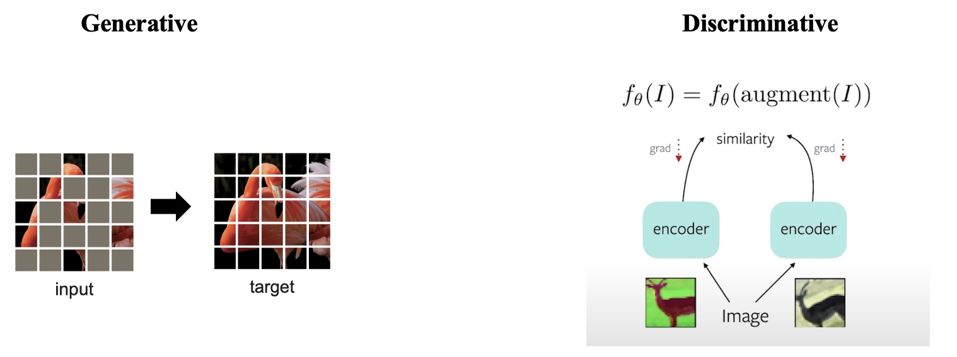
The Impact of training paradigm on visual explanations
Motivation
In more recent times new pre-training paradigms have emerged:
Self-Supervised Visual Pre-training ⭐️
Masked Auto Encoders
MoCo, BYOL, DINO
Talk @ GMUM 2024 | Siddhartha Gairola
46

Slide 47
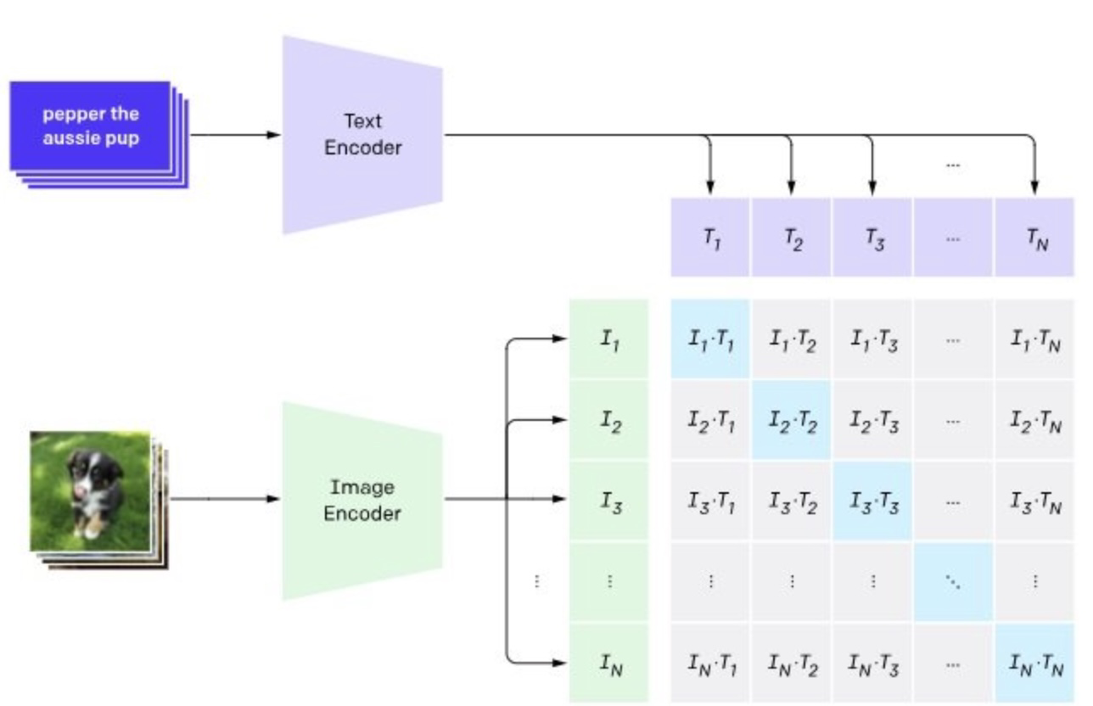
The Impact of training paradigm on visual explanations
Motivation
In more recent times new pre-training paradigms have emerged:
Self-Supervised Visual Pre-training ⭐️
Vision Language Pre-training ⭐️
Masked Auto Encoders
MoCo, BYOL, DINO
CLIP
Talk @ GMUM 2024 | Siddhartha Gairola
47

Slide 48
The Impact of training paradigm on visual explanations
Key-Finding
Training objective of classification layer (<10% of model parameters)
more crucial than pre-training paradigm.
Talk @ GMUM 2024 | Siddhartha Gairola
48

Slide 49
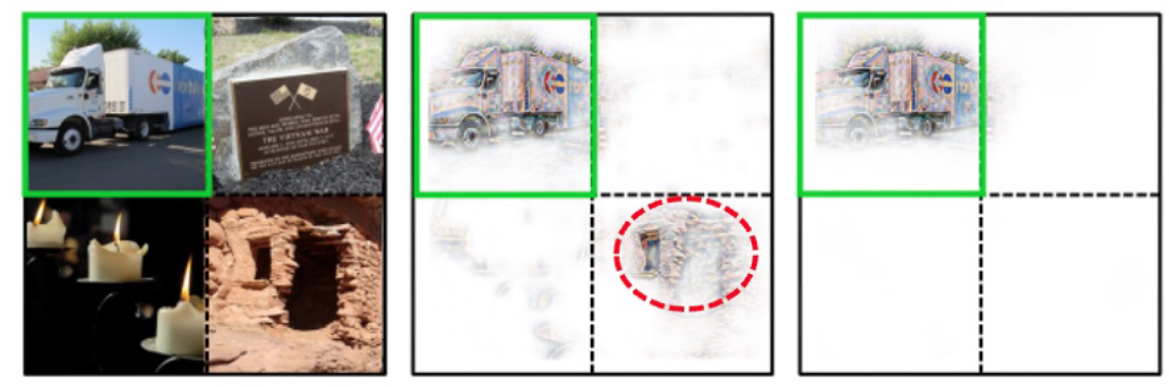
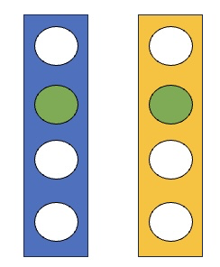
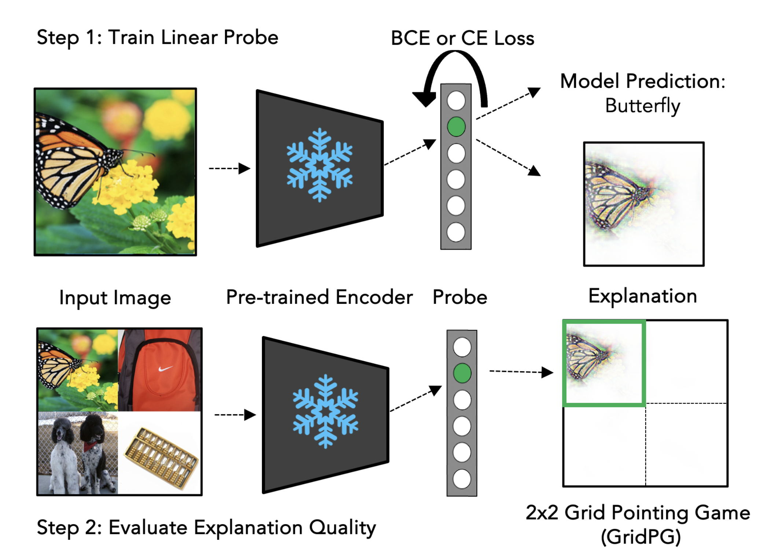
The Impact of training paradigm on visual explanations
Key-Finding
Training objective of classification layer (<10% of model parameters)
more crucial than pre-training paradigm.
Trailer-Truck
Frozen Encoder
CE-Loss
Linear Probes
Sigmoid-Loss
Talk @ GMUM 2024 | Siddhartha Gairola
49

Slide 50
The Impact of training paradigm on visual explanations
Holistic study to analyse the impact of pre-training on att. methods
Models
+ ResNets
+ ViTs
Training Frameworks
+ Supervised
+ Self-Supervised
DINO, MOCO, BYOL, CLIP, …
Attribution Methods
+ Post-hoc
+ Inherently Interpretable
Talk @ GMUM 2024 | Siddhartha Gairola
50

Slide 51
The Impact of training paradigm on visual explanations
Setup
Talk @ GMUM 2024 | Siddhartha Gairola
51

Slide 52
The Impact of training paradigm on visual explanations
Setup
Talk @ GMUM 2024 | Siddhartha Gairola
52

Slide 53
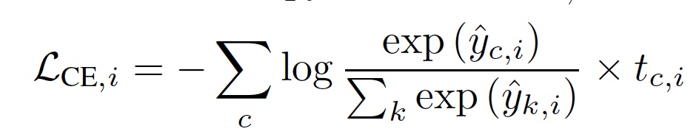
The Impact of training paradigm on visual explanations
Softmax Invariance Issue [1, 2]
y (predicted logits), t (one-hot target)
Probing pre-trained models with CE-loss lead to diffused attribution maps.
[1] (Srinivas & Fleuret, 2021); [2] (cf. Sundararajan et al. (2017)
Talk @ GMUM 2024 | Siddhartha Gairola
53

Slide 54
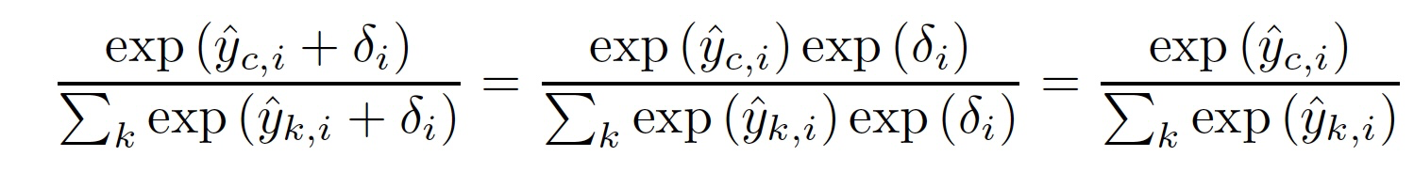
The Impact of training paradigm on visual explanations
Softmax Invariance Issue [1, 2]
Softmax-function used in CE-loss is invariant to a constant shift that is added to final classifier layer.
[1] (Srinivas & Fleuret, 2021); [2] (cf. Sundararajan et al. (2017)
Talk @ GMUM 2024 | Siddhartha Gairola
54

Slide 55
The Impact of training paradigm on visual explanations
Softmax Invariance Issue
Softmax-function used in CE-loss is invariant to a constant shift that is added to final classifier layer.
Talk @ GMUM 2024 | Siddhartha Gairola
55

Slide 56
The Impact of training paradigm on visual explanations
Softmax Invariance Issue
Softmax-function used in CE-loss is invariant to a constant shift that is added to final classifier layer.
Talk @ GMUM 2024 | Siddhartha Gairola
56

Slide 57
The Impact of training paradigm on visual explanations
Softmax Invariance Issue
An image-specific shift can be obtained by shifting the probes’ weight vectors w_{k} for all classes k by a fixed vector w’_{k} = w_{k}+𝚫w
Talk @ GMUM 2024 | Siddhartha Gairola
57

Slide 58
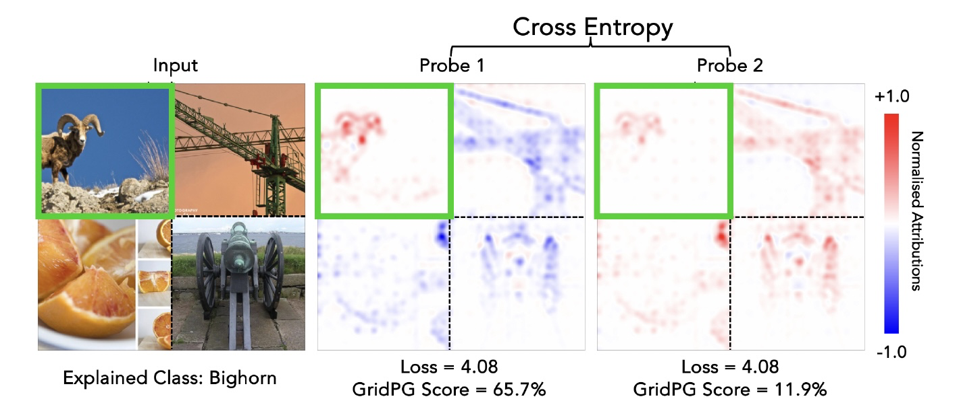
The Impact of training paradigm on visual explanations
Softmax Invariance Issue
An image-specific shift can be obtained by shifting the probes’ weight vectors w_{k} for all classes k by a fixed vector w’_{k} = w_{k}+𝚫w
Talk @ GMUM 2024 | Siddhartha Gairola
58

Slide 59
The Impact of training paradigm on visual explanations
Softmax Invariance Issue
1. Sigmoid (or BCE) Loss independently maximises (negative) class logits.
Talk @ GMUM 2024 | Siddhartha Gairola
59

Slide 60
The Impact of training paradigm on visual explanations
Softmax Invariance Issue
1. Sigmoid (or BCE) Loss independently maximises (negative) class logits.
2. For Sigmoid (or BCE) Loss, the probe is penalized for adding a constant positive shift to non-target classes and thus biased towards focusing on class-specific features.
Talk @ GMUM 2024 | Siddhartha Gairola
60

Slide 61
The Impact of training paradigm on visual explanations
Results and Findings
Talk @ GMUM 2024 | Siddhartha Gairola
61

Slide 62
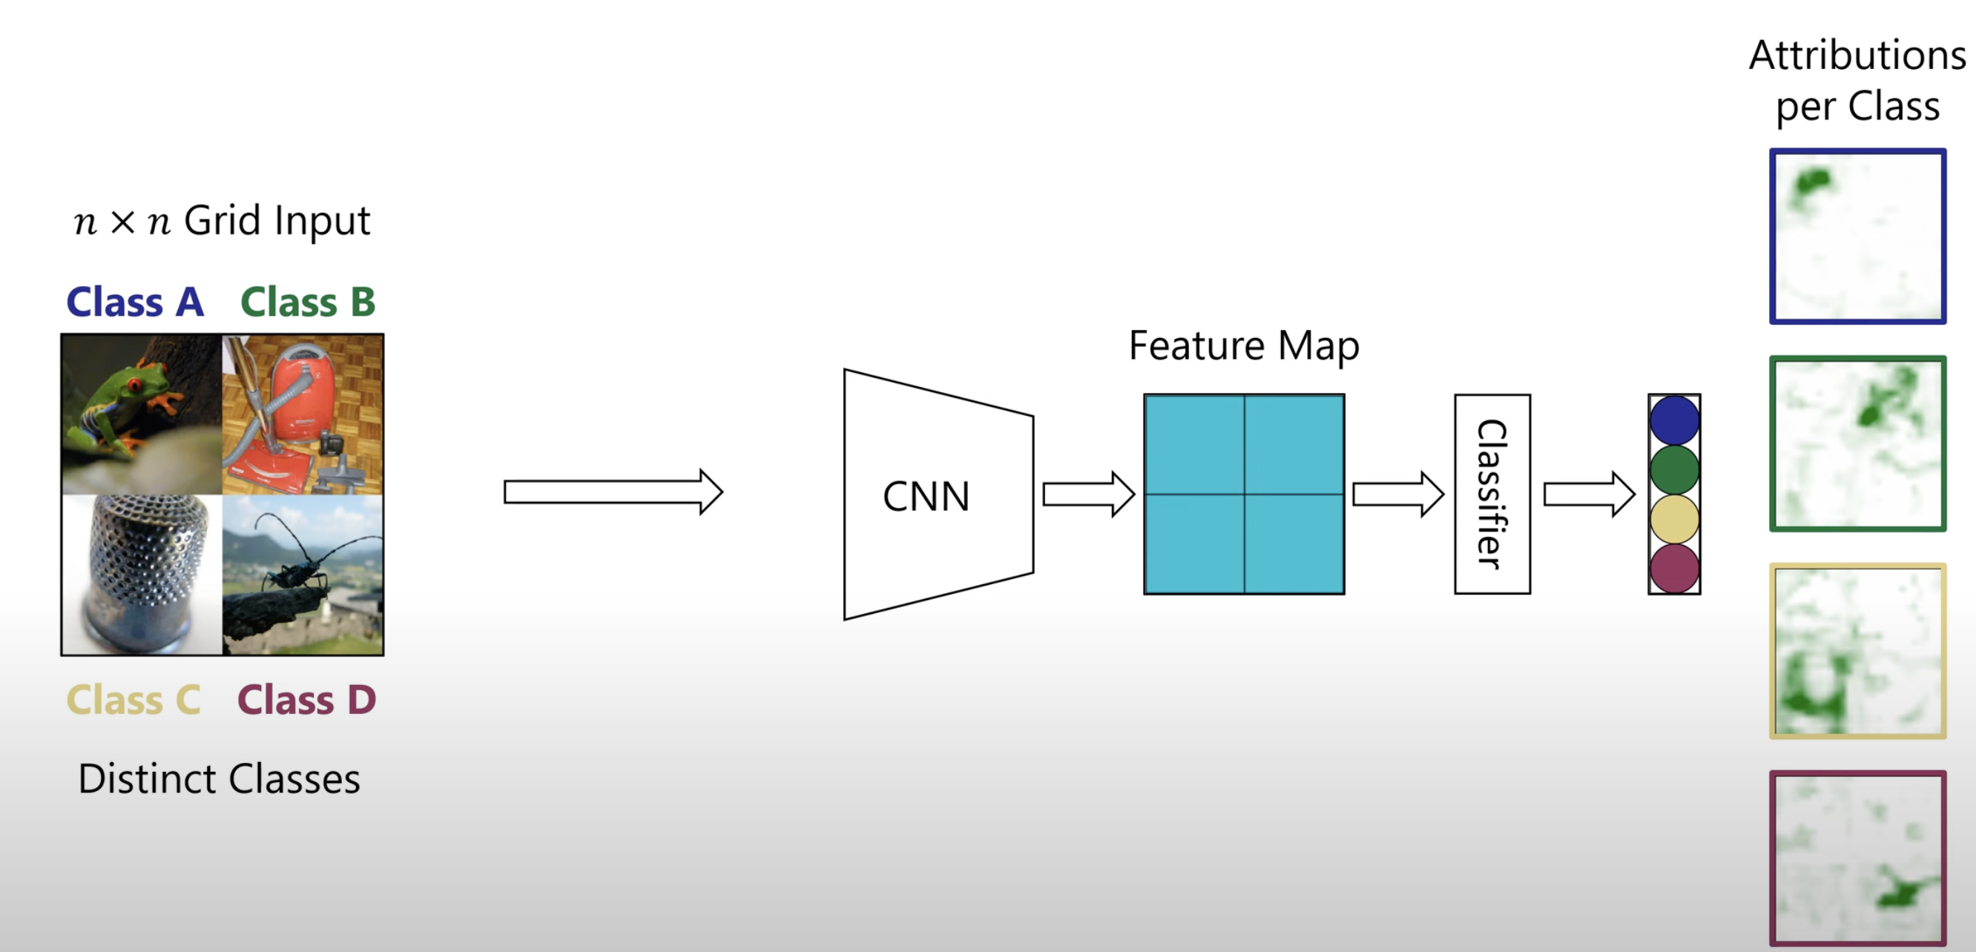
The Impact of training paradigm on visual explanations
Quick Interlude - Evaluations of attributions
Grid pointing game - GridPG
Boehle et al. 2021, CoDA Nets
Slide Credit: Sukrut Rao 2022
Talk @ GMUM 2024 | Siddhartha Gairola
62

Slide 63
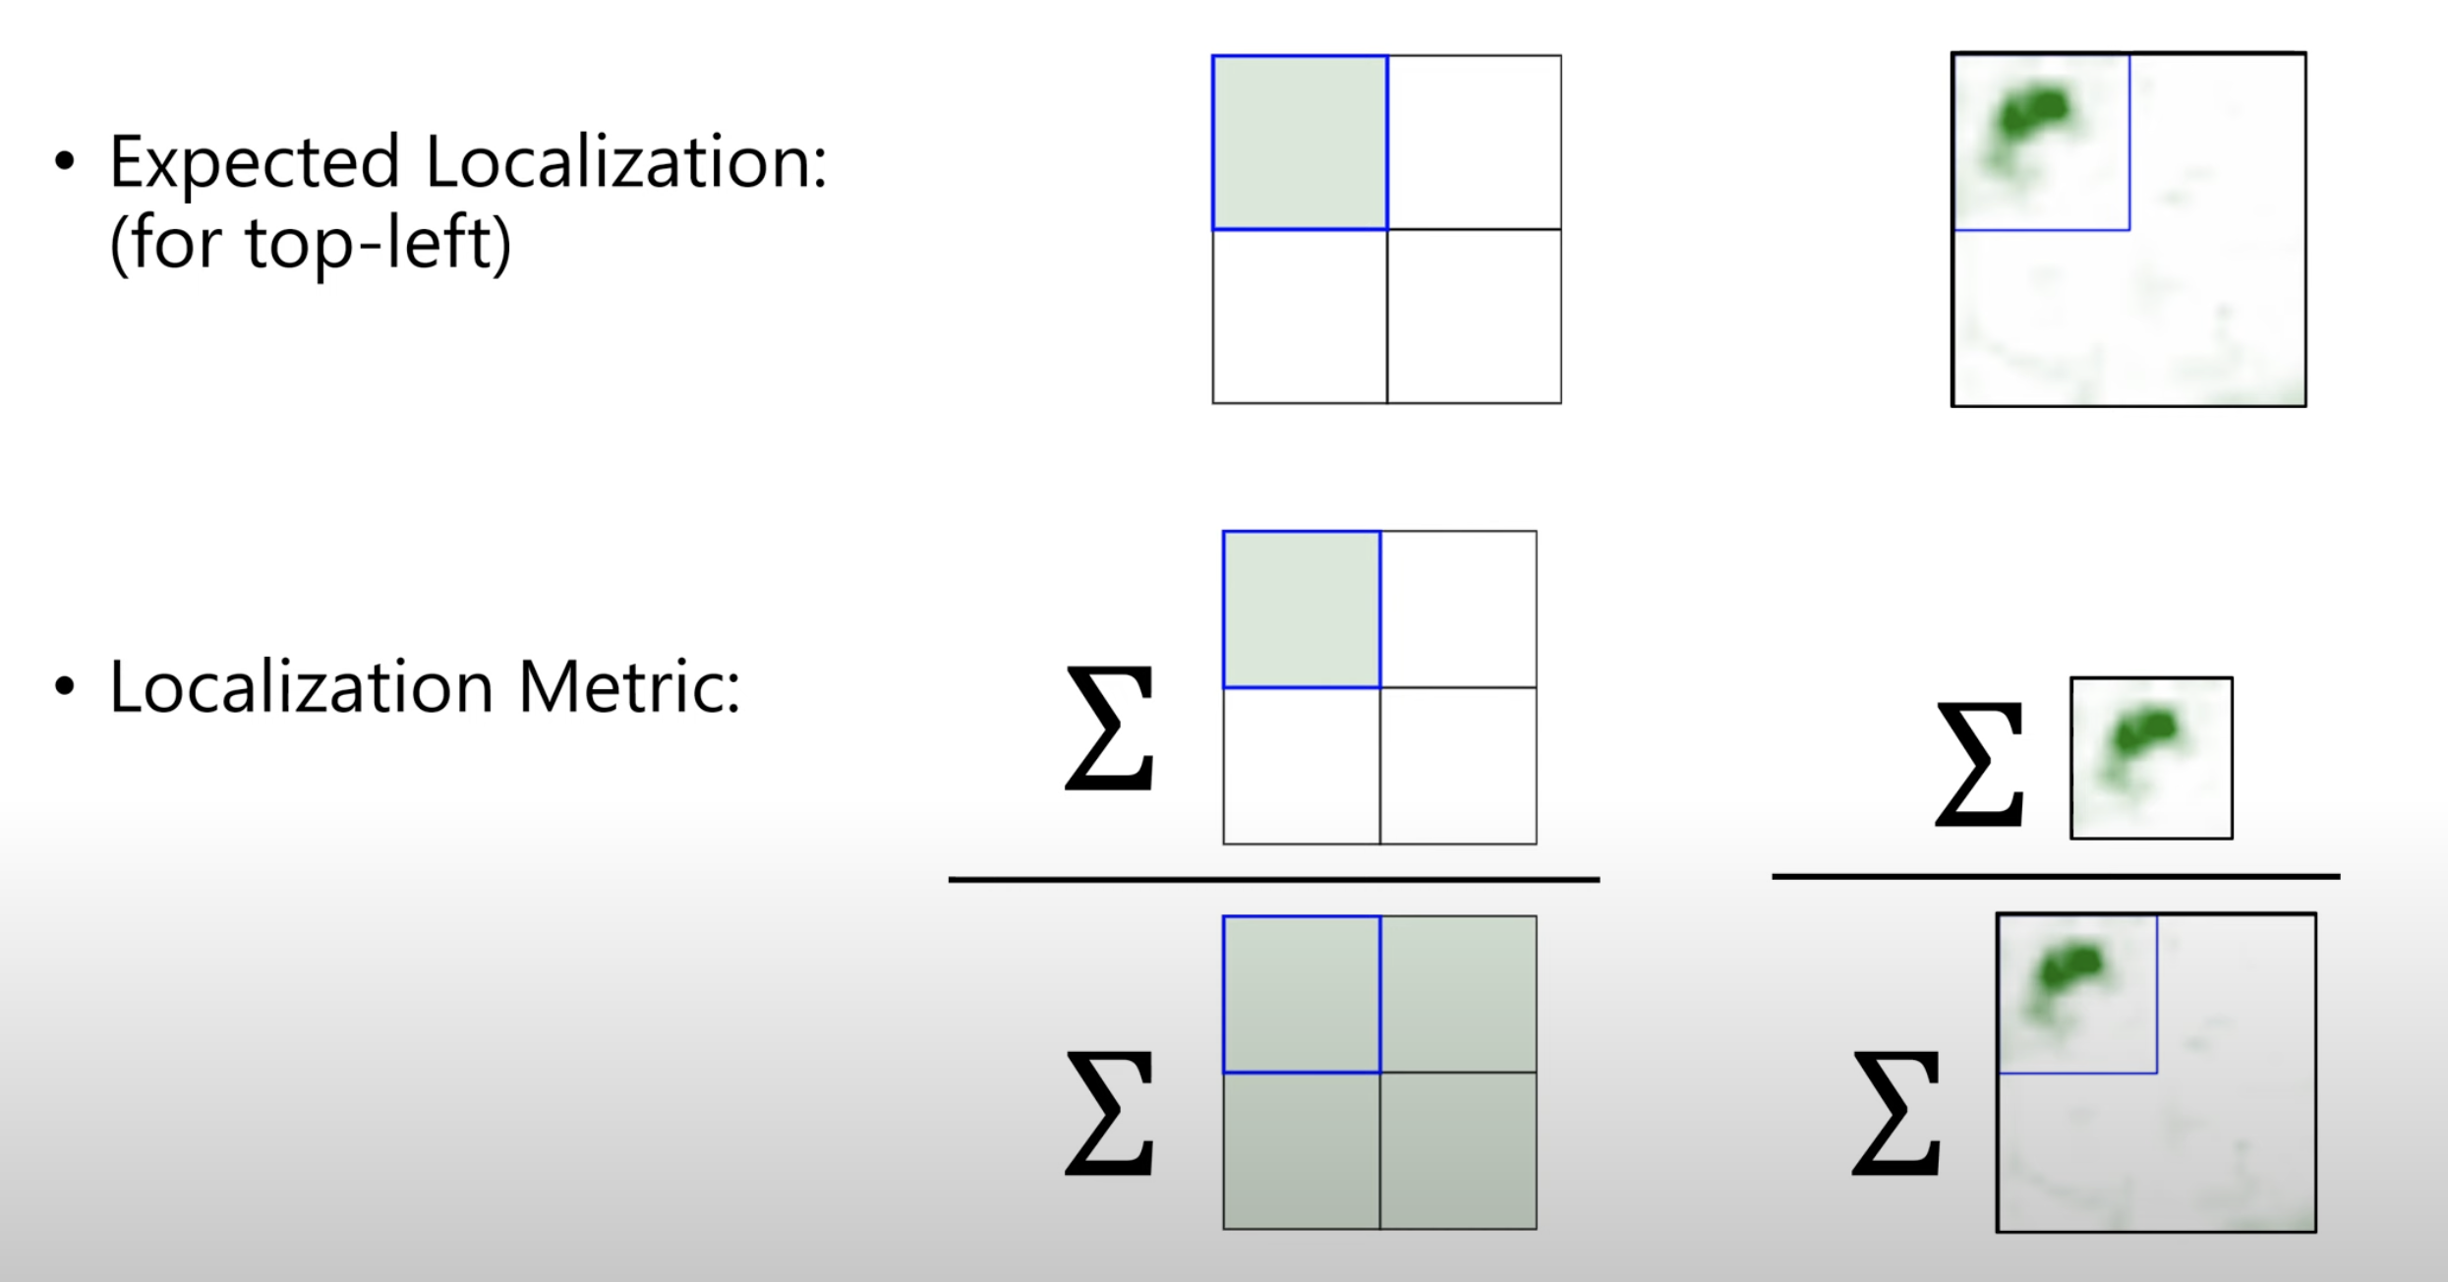
The Impact of training paradigm on visual explanations
Quick Interlude - Evaluations of attributions
Grid pointing game - GridPG
Boehle et al. 2021, CoDA Nets
Slide Credit: Sukrut Rao 2022
Talk @ GMUM 2024 | Siddhartha Gairola
63

Slide 64
The Impact of training paradigm on visual explanations
Quick Interlude - Evaluations of attributions
Pixel Deletion Metric – Deleting least important pixels highlighted by the attribution map, should preserve the prediction.
Other metrics - Compactness (Gini-index), Complexity (Entropy)
Talk @ GMUM 2024 | Siddhartha Gairola
64

Slide 65
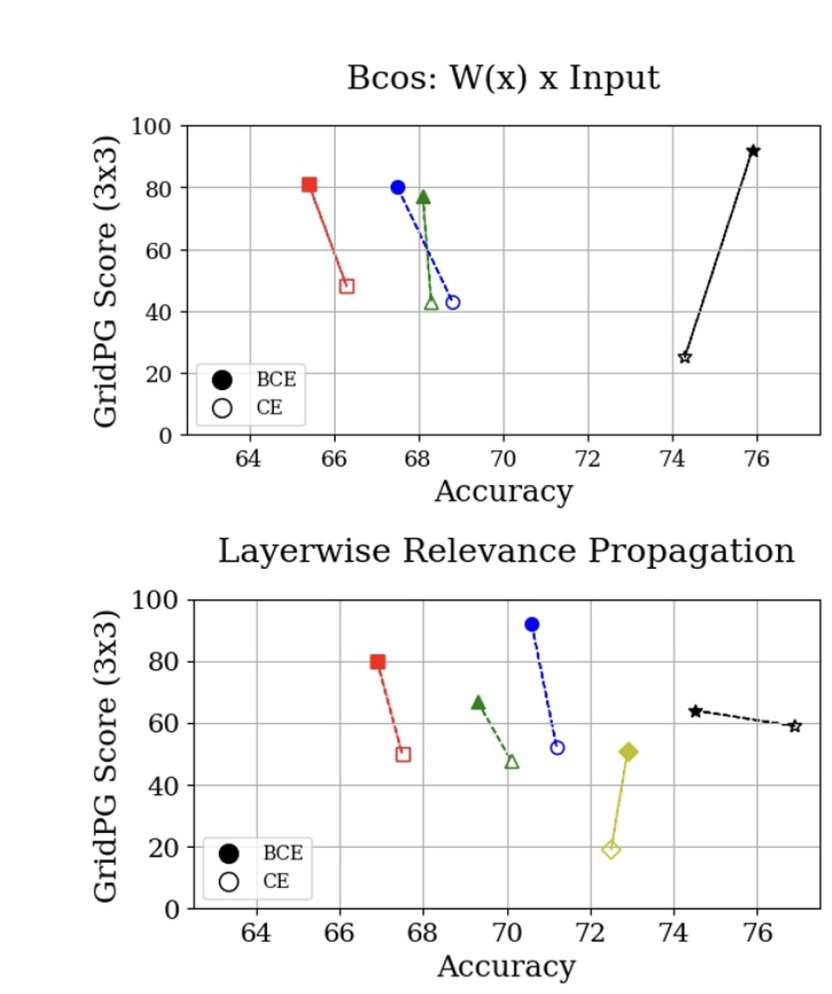
The Impact of training paradigm on visual explanations
Results and Findings Linear Classification on ImageNet
1. Training object of classification layer, has a drastic impact on the quality of attributions
using BCE instead of CE improves the localization of model explanations by upto 40%.
Talk @ GMUM 2024 | Siddhartha Gairola
65
Notes:
Maximise the correct class or maximise the negative class logit of the incorrect classes.

Slide 66
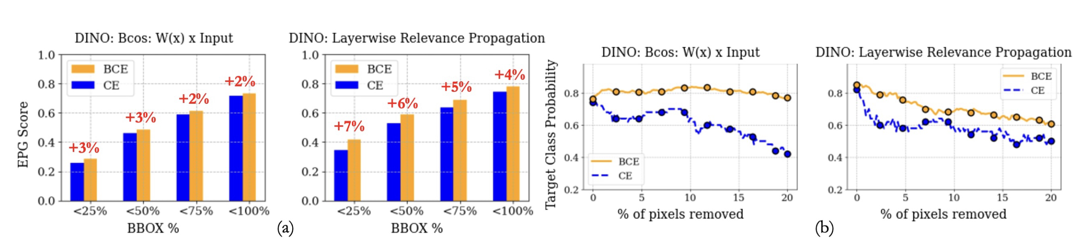
The Impact of training paradigm on visual explanations
Results and Findings
1. Training object of classification layer, has a drastic impact on the quality of attributions
Talk @ GMUM 2024 | Siddhartha Gairola
66

Slide 67
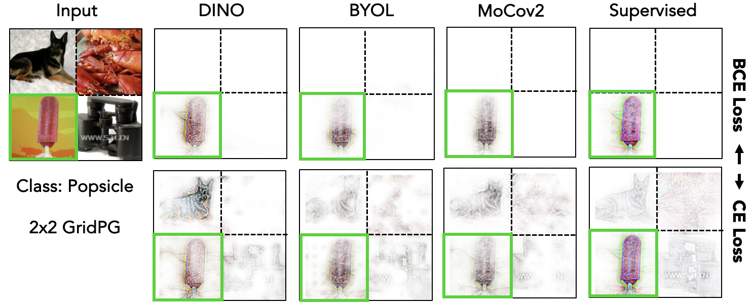
The Impact of training paradigm on visual explanations
Results and Findings Linear Classification on ImageNet
1. Training object of classification layer, has a drastic impact on the quality of attributions
Talk @ GMUM 2024 | Siddhartha Gairola
67

Slide 68
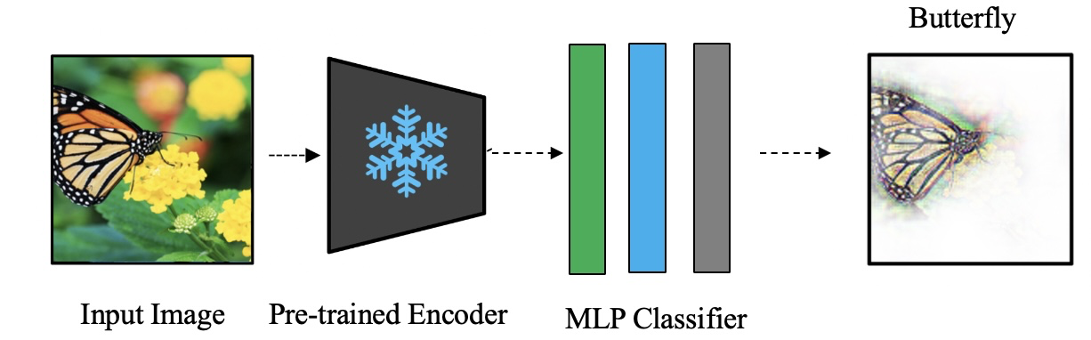
The Impact of training paradigm on visual explanations
Results and Findings Classification on ImageNet
2. Stronger MLP Classifier Improves Localization
Since self-supervised pre-training learn general representations and are not optimized to be linearly separable with respect to downstream dataset classes:
+ extracting class-specific features with a single linear probes can be challenging!
+ Stronger Bcos-MLP classifiers (probing) improve both accuracy and localization
Talk @ GMUM 2024 | Siddhartha Gairola
68

Slide 69
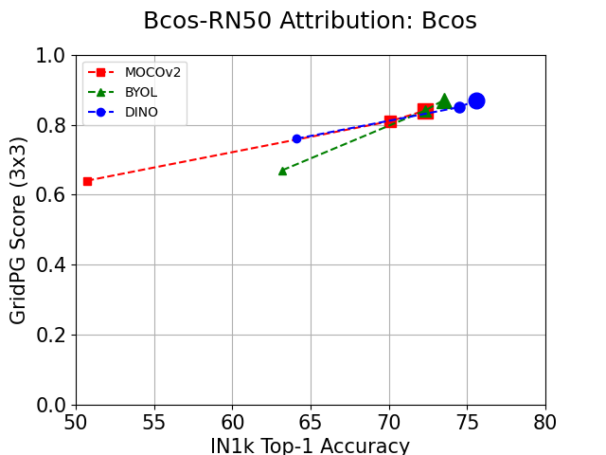
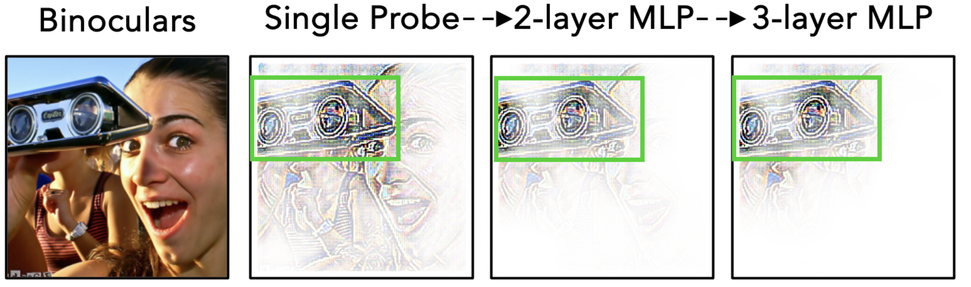
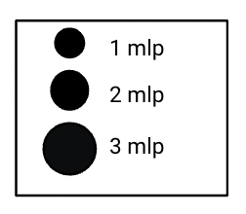
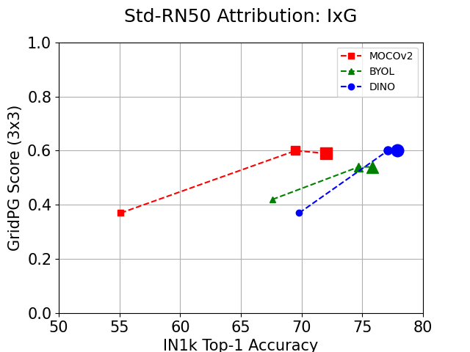
The Impact of training paradigm on visual explanations
Results and Findings Classification on ImageNet
DINO
Stronger probes distil class-specific features!
Talk @ GMUM 2024 | Siddhartha Gairola
69

Slide 70
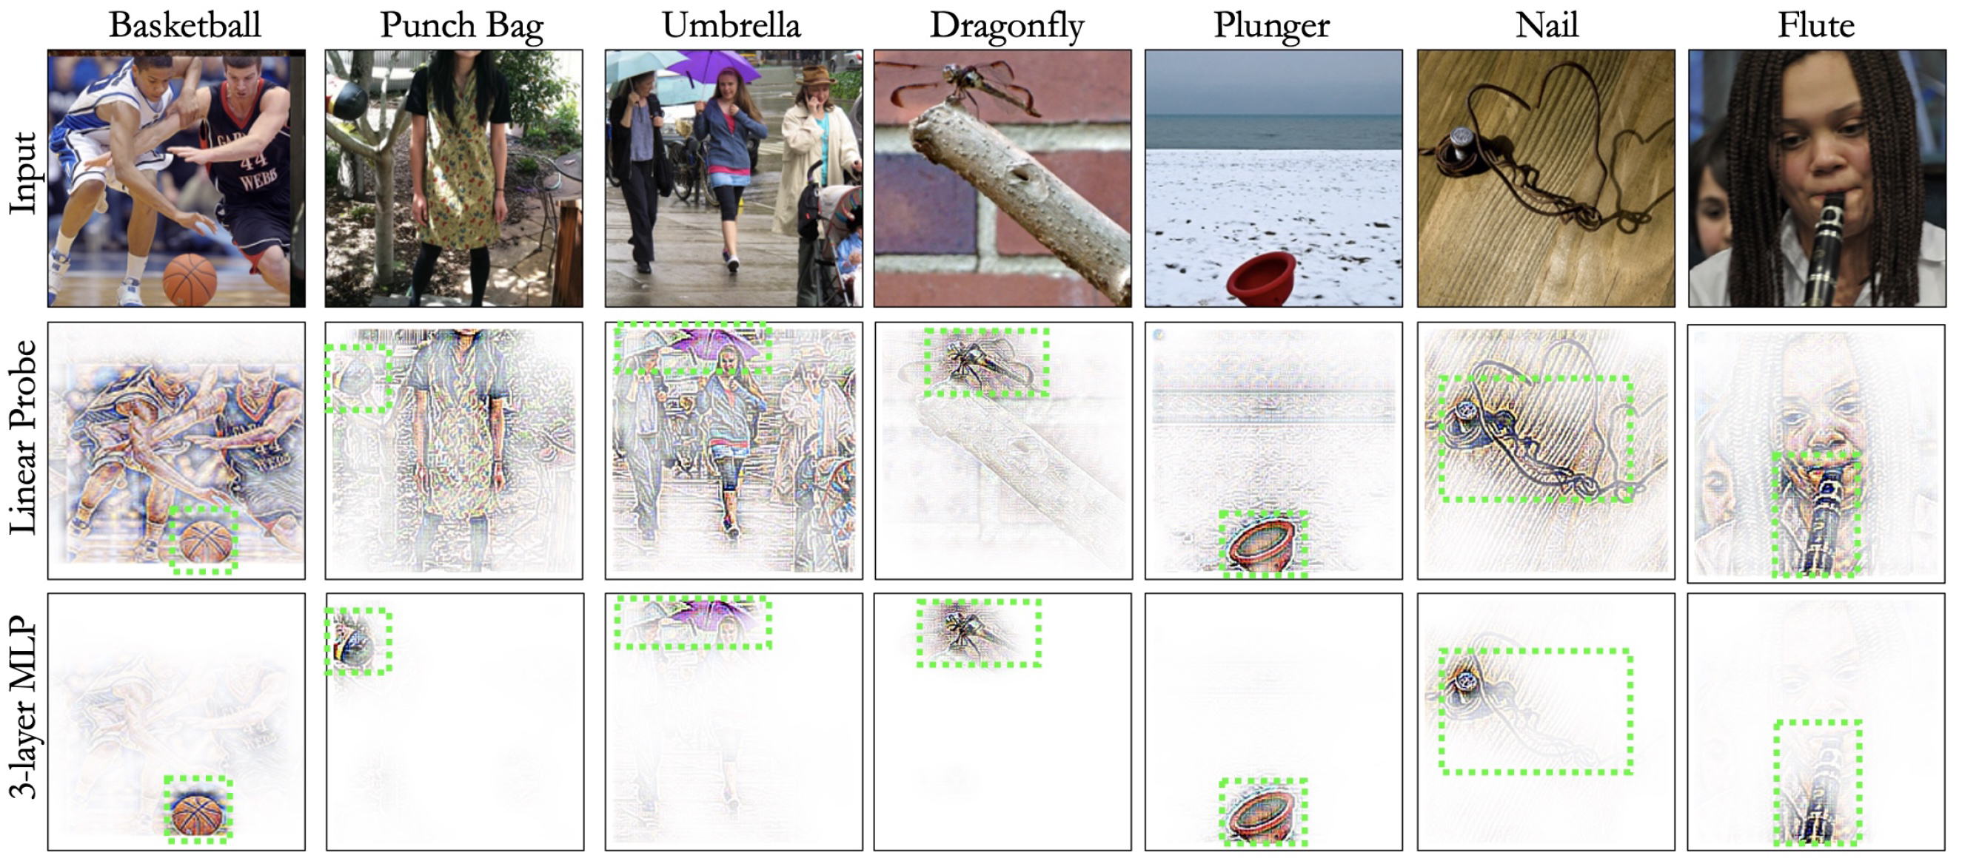
The Impact of training paradigm on visual explanations
Results and Findings Classification on ImageNet
Stronger probes distil class-specific features!
Talk @ GMUM 2024 | Siddhartha Gairola
70

Slide 71
The Impact of training paradigm on visual explanations
Key Takeaways
We find SSL models to work well with post-hoc explanation (attribution) methods, BUT
The objective used to train the classifier on downstream tasks can have a huge influence on model explanations =>
using BCE instead of CE improves the localization of model explanations by upto 40%.
Stronger Bcos MLP probes improve both performance and explanation localization.
We also show that inherently interpretable B-cos models are compatible with SSL training, leading to highly interpretable and performant models.
Talk @ GMUM 2024 | Siddhartha Gairola
71

Slide 72
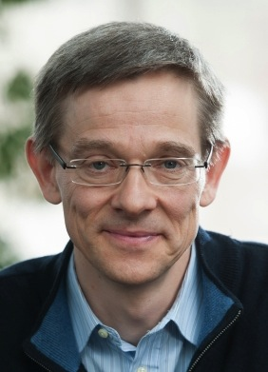


Acknowledgements
Bernt Schiele
Francesco Locatello
Sukrut Rao
Moritz Böhle
Amin Parchami-Araghi
Talk @ GMUM 2024 | Siddhartha Gairola
72

Slide 73
questions, comments …
Thank you all!
Have a nice weekend
😊
Talk @ GMUM 2024 | Siddhartha Gairola
73

Slide 74
References
1. Böhle, M.D., Fritz, M., & Schiele, B. B-cos Networks: Alignment is All We Need for Interpretability. CVPR 2022.
2. Böhle, M.D., Singh, N., Fritz, M., & Schiele, B. B-Cos Alignment for Inherently Interpretable CNNs and Vision Transformers. PAMI 2023.
3. Rao, S., Böhle, M., Parchami-Araghi, A., & Schiele, B. Studying How to Efficiently and Effectively Guide Models with Explanations. ICCV 2023.
4. Parchami-Araghi, A., Böhle, M., Rao, S., & Schiele, B. Good Teachers Explain: Explanation-Enhanced Knowledge Distillation. ECCV 2024.
5. Gairola, S., Böhle, M., Locatello, F., & Schiele, B. How to Probe: Simple Yet Effective Techniques for Improving Post-hoc Explanations (under review, 2024)
Talk @ GMUM 2024 | Siddhartha Gairola
74

Slide 75
Backup Slides
Talk @ GMUM 2024 | Siddhartha Gairola
75

Slide 76
The Impact of training paradigm on visual explanations
Results and Findings
1. Training object of classification layer, has a drastic impact on the quality of attributions
Talk @ GMUM 2024 | Siddhartha Gairola
76

Slide 77
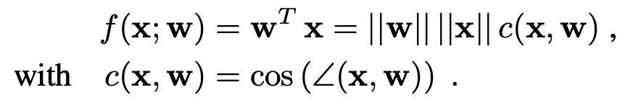
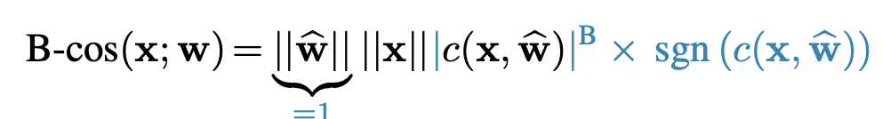
B-cos Networks (Details): Standard vs B-cos Transform
Standard Linear Transform:
B-cos Transform:
B-Cos Nets (Böhle et al. 2022)
Talk @ GMUM 2024 | Siddhartha Gairola
77

Slide 78
B-cos Networks (Details): Dynamic Linearity
B-Cos Nets (Böhle et al. 2022)
Talk @ GMUM 2024 | Siddhartha Gairola
78

Slide 79
B-cos Networks (Details): Dynamic Linearity
Dynamic linearity allows to faithfully summarise the model.
Faithful
✅
B-Cos Nets (Böhle et al. 2022)
Talk @ GMUM 2024 | Siddhartha Gairola
79

Slide 80
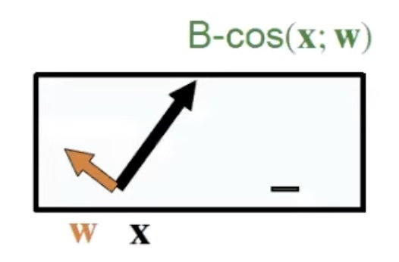
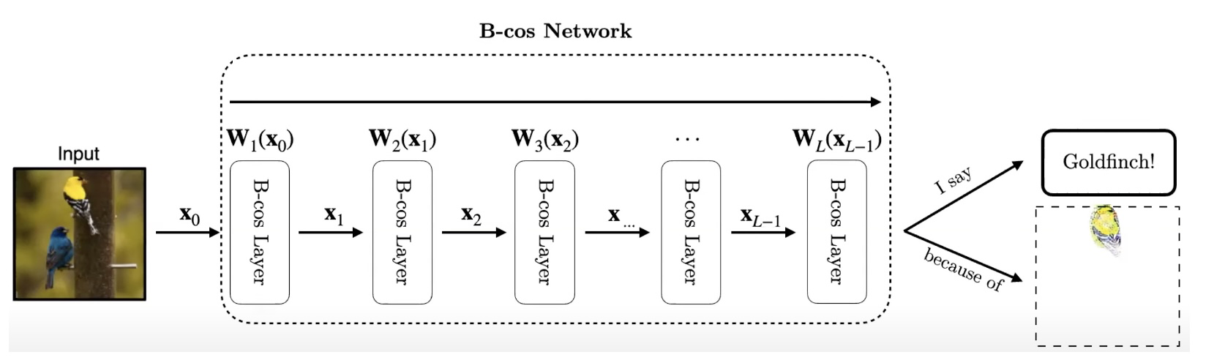
B-cos Networks (Details): Alignment Pressure
B-cos Transform
B-Cos Nets (Böhle et al. 2022)
Talk @ GMUM 2024 | Siddhartha Gairola
80

Slide 81

B-cos Networks (Details): Alignment Pressure
B-cos Transform
Interpretable
✅
B-Cos Nets (Böhle et al. 2022)
Talk @ GMUM 2024 | Siddhartha Gairola
81

Slide 82
B-cos Networks (Details): Alignment Pressure
Explanations
Faithful
Interpretable
✅
✅
B-Cos Nets (Böhle et al. 2022)
Talk @ GMUM 2024 | Siddhartha Gairola
82

Slide 83


B-cos Networks (Details): Well localizing attributions
B-Cos Nets (Böhle et al. 2022)
Talk @ GMUM 2024 | Siddhartha Gairola
83

Slide 84
Guiding models with visual explanations
Leverage human annotations
Effective Guidance
In-depth study across:
Evaluation Metrics
Loss Functions
Model Types
Attribution Methods
Guidance Depths
Datasets
Model Guidance (Rao et al. 2023), Slide Credit – Sukrut Rao, 2023
Talk @ GMUM 2024 | Siddhartha Gairola
84

Slide 85
Guiding models with visual explanations
Leverage human annotations
Effective Guidance
Efficient Guidance
In-depth study across:
Evaluation Metrics
Loss Functions
Model Types
Attribution Methods
Guidance Depths
Datasets
Low guidance cost:
Bounding Boxes
Coarse Annotations
Limited Annotations
Varying Guidance Depths
Model Guidance (Rao et al. 2023), Slide Credit – Sukrut Rao, 2023
Talk @ GMUM 2024 | Siddhartha Gairola
85

Slide 86

Guiding models with visual explanations - e²KD
Desideratum 1 – High agreement with teacher
Distillation: B-cos Densenet-169 -> B-cos ResNet-18
e²KD provides gains even on unrelated images.
E²KD (Parchami et al. 2023), Slide Credit – Amin Parchami-Araghi, 2023
Talk @ GMUM 2024 | Siddhartha Gairola
86

Slide 87

Guiding models with visual explanations - e²KD
Summary
E²KD (Parchami et al. 2023), Slide Credit – Amin Parchami-Araghi, 2023
Talk @ GMUM 2024 | Siddhartha Gairola
87

